Slide 1
Child Mortality Prediction using Machine Learning

Slide 2
Abstract_ Children under the age of five are considered to be mortal in this context. The death rate for children under the age of five, or the under-five death rate, refers to the likelihood of dying between the ages of birth and the age of five. The death of a fetus is just as common as the death of a kid. The goal is to study ML based strategies for determining the mortality fetal well-being arrangement that provides the best precision.here we using three ML algorithms i.e SVM,Random Forest and decision tree to predict outpur . Using the results of this study, a complete approach has been developed to sensitivity analysis for model parameters that affect fetal health categorization. This paper proposes a machine learning-based approach for predicting child mortality and compares various machine learning methods against the provided dataset.
Existing system:
Patients' conditions in the intensive care unit can be used to predict post-ICU mortality using a new information-driven strategy. Models that aggregate and
transform data from several patients into a SAPS II-based sequence have been built in this study to represent the patient's individual condition [13]. Analysis of in-ICU
conditions and post-ICU survival is done using a logistic regression model. After a period of time in the ICU, it is best to keep a close eye on the patient's condition.
Another trading state-space model will be developed in this audit, and it will link the risks associated with prolonged stays in the intensive care unit (ICU) to the patient's
condition components [14,15]. In order to ensure that the training data is balanced, the minority class (death) is oversampled in the data. Further research into which
physiological indicators best distinguish between the projected and actual outcomes of ICU patients is a goal of ours, along with predicting death.
DISADVANTAGES:
Accuracy is Low.
Only using Data Mining algorithms.
Proposed work:
The idea is to put together a model that can predict death rates. It is possible that the

Slide 3
information acquired has missing attributes that could lead to irregularity. The calculation's productivity can be improved by pre-processing data in order to achieve better results. Exemptions should be eliminated, and factor changes should be implemented as well. There are two parts to the informative index used for anticipating provided information. 7:3 is the most common ratio used for training and testing sets. In order to measure the accuracy of the test results, a Data Model based on ML algorithms is applied to the Training set. The death rate can be characterized using the model. There are a wide range of ML algorithms that can be employed for representation, and they all work.
ADVANTAGES:
Accuracy is Very high.
Better Prediction .

Slide 4
CHAPTER 1 INTRODUCTION
Artificial intelligence (AI) is the study of how to get computers to do things on their own, without being explicitly programmed to do so. In the last decade, AI has brought us self-driving cars, feasible discourse acknowledgment, strong web search, and a vastly improved understanding of the human genome. AI is so pervasive today that you probably use it without even realising it on a daily basis. There are many experts who believe this is the greatest way to progress toward human-level AI. In this course, the most effective AI techniques is discussed and putting them into action and getting them to function on their own has been practiced. Furthermore, the theoretical foundations of learning while developing the practical skills necessary to apply these tactics to new situations has been illustrated. Finally, some of the Silicon Valley's best practises for AI and AI development are studied.

Slide 5
CHAPTER 2
LITERATURE SURVEY
Title: "Machine Learning Approaches for Predicting Child Mortality in Sub- Saharan Africa"
Authors: Johnson, O., & Ariyo, O.
Abstract: This study explores the application of machine learning algorithms to predict child mortality in Sub-Saharan Africa. The authors utilized a dataset comprising demographic, socioeconomic, and health indicators from multiple countries in the region. Various machine learning algorithms, including decision trees, random forests, and support vector machines, were implemented and evaluated. The results demonstrated promising predictive performance, with random forests achieving the highest accuracy. The study highlights the potential of machine learning in improving child mortality prediction models and facilitating targeted interventions in resource-limited settings.
Title: "Predicting Neonatal Mortality Using Machine Learning Techniques" Authors: Gupta, R., Kumar, R., & Sharma, D.
Abstract: Neonatal mortality remains a significant challenge worldwide, particularly in low-resource settings. In this research, the authors applied machine learning techniques to predict neonatal mortality using a dataset comprising maternal and neonatal health data. Logistic regression, artificial neural networks, and ensemble methods were employed, and their performance was evaluated using sensitivity, specificity, and AUC-ROC metrics. The results indicated that the ensemble method outperformed other algorithms, achieving a high predictive accuracy. The study highlights the potential of machine learning in identifying high-risk neonates and guiding healthcare interventions to reduce neonatal mortality.
Title: "Child Mortality Prediction Using Machine Learning: A Comparative Study" Authors: Ahmed, F., et al.

Slide 6
Abstract: This study presents a comparative analysis of machine learning algorithms for child mortality prediction using a comprehensive dataset encompassing socioeconomic, demographic, and healthcare indicators. The authors explored decision trees, support vector machines, logistic regression, and ensemble methods, considering different feature selection techniques. Performance evaluation metrics, including accuracy and AUC-ROC, were used to assess the models. The findings revealed that ensemble methods consistently outperformed other algorithms, emphasizing their effectiveness in predicting child mortality. The study contributes to the understanding of the most suitable machine learning techniques for child mortality prediction and their potential impact on public health interventions..

Slide 7
CHAPTER 3 TECHNOLOGIES LEARNT
What is Python :-
Below are some facts about Python.
Python is currently the most widely used multi-purpose, high-level programming language.
Python allows programming in Object-Oriented and Procedural paradigms. Python programs generally are smaller than other programming languages like Java.
Programmers have to type relatively less and indentation requirement of the language, makes them readable all the time.
Python language is being used by almost all tech-giant companies like – Google, Amazon, Facebook, Instagram, Dropbox, Uber… etc.
The biggest strength of Python is huge collection of standard library which can be used for the following –
•
•
Machine Learning
GUI Applications (like Kivy, Tkinter, PyQt etc. )
Web frameworks like Django (used by YouTube, Instagram, Dropbox) Image processing (like OpenCV, Pillow)
Web scraping (like Scrapy, BeautifulSoup, Selenium)
Test frameworks Multimedia
•
•
•
•
•
Advantages of Python :-
Let’s see how Python dominates over other languages.
1. Extensive Libraries
Python downloads with an extensive library and it contain code for various purposes like regular expressions, documentation-generation, unit-testing, web browsers, threading, databases, CGI, email, image manipulation, and more. So, we don’t have to write the complete code for that manually.

Slide 8
Extensible
As we have seen earlier, Python can be extended to other languages. You can write some of your code in languages like C++ or C. This comes in handy, especially in projects.
Embeddable
Complimentary to extensibility, Python is embeddable as well. You can put your Python code in your source code of a different language, like C++. This lets us add scripting capabilities to our code in the other language.
Improved Productivity
The language’s simplicity and extensive libraries render programmers more productive than languages like Java and C++ do. Also, the fact that you need to write less and get more things done.
IOT Opportunities
Since Python forms the basis of new platforms like Raspberry Pi, it finds the future bright for the Internet Of Things. This is a way to connect the language with the real world.
6. Simple and Easy
When working with Java, you may have to create a class to print ‘Hello World’. But in Python, just a print statement will do. It is also quite easy to learn, understand, and code. This is why when people pick up Python, they have a hard time adjusting to other more verbose languages like Java.
Readable
Because it is not such a verbose language, reading Python is much like reading English. This is the reason why it is so easy to learn, understand, and code. It also does not need curly braces to define blocks, and indentation is mandatory. This further aids the readability of the code.
Object-Oriented
This language supports both the procedural and object- oriented programming paradigms. While functions help us with code

Slide 9
reusability, classes and objects let us model the real world. A class allows the encapsulation of data and functions into one.
Free and Open-Source
Like we said earlier, Python is freely available. But not only can you download Python for free, but you can also download its source code, make changes to it, and even distribute it. It downloads with an extensive collection of libraries to help you with your tasks.
Portable
When you code your project in a language like C++, you may need to make some changes to it if you want to run it on another platform. But it isn’t the same with Python. Here, you need to code only once, and you can run it anywhere. This is called Write Once Run Anywhere (WORA). However, you need to be careful enough not to include any system-dependent features.
Interpreted
Lastly, we will say that it is an interpreted language. Since statements are executed one by one, debugging is easier than in compiled languages.
Any doubts till now in the advantages of Python? Mention in the comment section.
Advantages of Python Over Other Languages
Less Coding
Almost all of the tasks done in Python requires less coding when the same task is done in other languages. Python also has an awesome standard library support, so you don’t have to search for any third-party libraries to get your job done. This is the reason that many people suggest learning Python to beginners.
Affordable
Python is free therefore individuals, small companies or big organizations can leverage the free available resources to build applications. Python is popular and widely used so it gives you better community support.

Slide 10
The 2019 Github annual survey showed us that Python has overtaken Java in the most popular programming language category.
3. Python is for Everyone
Python code can run on any machine whether it is Linux, Mac or Windows. Programmers need to learn different languages for different jobs but with Python, you can professionally build web apps, perform data analysis and machine learning, automate things, do web scraping and also build games and powerful visualizations. It is an all-rounder programming language.
Disadvantages of Python
So far, we’ve seen why Python is a great choice for your project. But if you choose it, you should be aware of its consequences as well. Let’s now see the downsides of choosing Python over another language.
Speed Limitations
We have seen that Python code is executed line by line. But since Python is interpreted, it often results in slow execution. This, however, isn’t a problem unless speed is a focal point for the project. In other words, unless high speed is a requirement, the benefits offered by Python are enough to distract us from its speed limitations.
Weak in Mobile Computing and Browsers
While it serves as an excellent server-side language, Python is much rarely seen on the client-side. Besides that, it is rarely ever used to implement smartphone-based applications. One such application is called Carbonnelle. The reason it is not so famous despite the existence of Brython is that it isn’t that secure.
10

Slide 11
Design Restrictions
As you know, Python is dynamically-typed. This means that you don’t need to declare the type of variable while writing the code. It uses duck- typing. But wait, what’s that? Well, it just means that if it looks like a duck, it must be a duck. While this is easy on the programmers during coding, it can raise run-time errors.
Underdeveloped Database Access Layers
Compared to more widely used technologies like JDBC (Java DataBase Connectivity) and ODBC (Open DataBase Connectivity), Python’s database access layers are a bit underdeveloped. Consequently, it is less often applied in huge enterprises.
Simple
No, we’re not kidding. Python’s simplicity can indeed be a problem. Take my example. I don’t do Java, I’m more of a Python person. To me, its syntax is so simple that the verbosity of Java code seems unnecessary.
This was all about the Advantages and Disadvantages of Python Programming Language.
History of Python : -
What do the alphabet and the programming language Python have in common? Right, both start with ABC. If we are talking about ABC in the Python context, it's clear that the programming language ABC is meant. ABC is a general-purpose programming language and programming environment, which had been developed in the Netherlands, Amsterdam, at the CWI (Centrum Wiskunde & Informatica). The greatest achievement of ABC was to influence the design of Python. Python was conceptualized in the late 1980s. Guido van Rossum worked that time in a project at the CWI, called Amoeba, a distributed operating system. In an interview with Bill Venners¹, Guido van Rossum said: "In the early 1980s, I worked as an implementer on a team building a language called ABC at Centrum voor

Slide 12
Wiskunde en Informatica (CWI). I don't know how well people know ABC's influence on Python. I try to mention ABC's influence because I'm indebted to everything I learned during that project and to the people who worked on it." Later on in the same Interview, Guido van Rossum continued: "I remembered all my experience and some of my frustration with ABC. I decided to try to design a simple scripting language that possessed some of ABC's better properties, but without its problems. So I started typing. I created a simple virtual machine, a simple parser, and a simple runtime. I made my own version of the various ABC parts that I liked. I created a basic syntax, used indentation for statement grouping instead of curly braces or begin-end blocks, and developed a small number of powerful data types: a hash table (or dictionary, as we call it), a list, strings, and numbers."
What is Machine Learning : -
Before we take a look at the details of various machine learning methods, let's start by looking at what machine learning is, and what it isn't. Machine learning is often categorized as a subfield of artificial intelligence, but I find that categorization can often be misleading at first brush. The study of machine learning certainly arose from research in this context, but in the data science application of machine learning methods, it's more helpful to think of machine learning as a means of building models of data.
Fundamentally, machine learning involves building mathematical models to help understand data. "Learning" enters the fray when we give these models tunable parameters that can be adapted to observed data; in this way the program can be considered to be "learning" from the data. Once these models have been fit to previously seen data, they can be used to predict and understand aspects of newly observed data. I'll leave to the reader the more philosophical digression regarding the extent to which this type of mathematical, model-based "learning" is similar to the "learning" exhibited by the human brain.Understanding the problem setting in machine learning is essential to using these tools effectively, and so we will start with some broad categorizations of the types of approaches we'll discuss here.

Slide 13
Categories Of Machine Leaning :-
At the most fundamental level, machine learning can be categorized into two main types: supervised learning and unsupervised learning.
Supervised learning involves somehow modeling the relationship between measured features of data and some label associated with the data; once this model is determined, it can be used to apply labels to new, unknown data. This is further subdivided into classification tasks and regression tasks: in classification, the labels are discrete categories, while in regression, the labels are continuous quantities. We will see examples of both types of supervised learning in the following section.
Unsupervised learning involves modeling the features of a dataset without reference to any label, and is often described as "letting the dataset speak for itself." These models include tasks such as clustering and dimensionality reduction. Clustering algorithms identify distinct groups of data, while dimensionality reduction algorithms search for more succinct representations of the data. We will see examples of both types of unsupervised learning in the following section.
Need for Machine Learning
Human beings, at this moment, are the most intelligent and advanced species on earth because they can think, evaluate and solve complex problems. On the other side, AI is still in its initial stage and haven’t surpassed human intelligence in many aspects. Then the question is that what is the need to make machine learn? The most suitable reason for doing this is, “to make decisions, based on data, with efficiency and scale”.
Lately, organizations are investing heavily in newer technologies like Artificial Intelligence, Machine Learning and Deep Learning to get the key information from data to perform several real-world tasks and solve problems. We can call it data-driven decisions taken by machines, particularly to automate the process. These data-driven decisions can be used, instead of using programing logic, in the problems that cannot be

Slide 14
programmed inherently. The fact is that we can’t do without human intelligence, but other aspect is that we all need to solve real-world problems with efficiency at a huge scale. That is why the need for machine learning arises.
Challenges in Machines Learning :-
While Machine Learning is rapidly evolving, making significant strides with cybersecurity and autonomous cars, this segment of AI as whole still has a long way to go. The reason behind is that ML has not been able to overcome number of challenges. The challenges that ML is facing currently are −
Quality of data − Having good-quality data for ML algorithms is one of the biggest challenges. Use of low-quality data leads to the problems related to data preprocessing and feature extraction.
Time-Consuming task − Another challenge faced by ML models is the consumption of time especially for data acquisition, feature extraction and retrieval.
Lack of specialist persons − As ML technology is still in its infancy stage, availability of expert resources is a tough job.
No clear objective for formulating business problems − Having no clear objective and well-defined goal for business problems is another key challenge for ML because this technology is not that mature yet.
Issue of overfitting & underfitting − If the model is overfitting or
underfitting, it cannot be represented well for the problem.
Curse of dimensionality − Another challenge ML model faces is too many
features of data points. This can be a real hindrance.
Difficulty in deployment − Complexity of the ML model makes it quite
difficult to be deployed in real life.
Applications of Machines Learning :-

Slide 15
Machine Learning is the most rapidly growing technology and according to researchers we are in the golden year of AI and ML. It is used to solve many real-world complex problems which cannot be solved with traditional approach. Following are some real-world applications of ML −
•
Emotion analysis
•
Sentiment analysis
Error detection and prevention
•
•
Weather forecasting and prediction
Stock market analysis and forecasting Speech synthesis
•
•
•
Speech recognition Customer segmentation
•
•
Object recognition Fraud detection
•
•
Fraud prevention
Recommendation of products to customer in online shopping
•
How to Start Learning Machine Learning?
Arthur Samuel coined the term “Machine Learning” in 1959 and defined it as a “Field of study that gives computers the capability to learn without being explicitly programmed”.
And that was the beginning of Machine Learning! In modern times, Machine Learning is one of the most popular (if not the most!) career
choices. According to Indeed, Machine Learning Engineer Is The Best Job of 2019 with a 344% growth and an average base salary of $146,085 per
year.
But there is still a lot of doubt about what exactly is Machine Learning and
how to start learning it? So this article deals with the Basics of Machine Learning and also the path you can follow to eventually become a full- fledged Machine Learning Engineer. Now let’s get started!!!

Slide 16
How to start learning ML?
This is a rough roadmap you can follow on your way to becoming an insanely talented Machine Learning Engineer. Of course, you can always modify the steps according to your needs to reach your desired end-goal!
Step 1 – Understand the Prerequisites
In case you are a genius, you could start ML directly but normally, there are some prerequisites that you need to know which include Linear Algebra, Multivariate Calculus, Statistics, and Python. And if you don’t know these, never fear! You don’t need a Ph.D. degree in these topics to get started but you do need a basic understanding.
(a) Learn Linear Algebra and Multivariate Calculus
Both Linear Algebra and Multivariate Calculus are important in Machine Learning. However, the extent to which you need them depends on your role as a data scientist. If you are more focused on application heavy machine learning, then you will not be that heavily focused on maths as there are many common libraries available. But if you want to focus on R&D in Machine Learning, then mastery of Linear Algebra and Multivariate Calculus is very important as you will have to implement many ML algorithms from scratch.
(b) Learn Statistics
Data plays a huge role in Machine Learning. In fact, around 80% of your time as an ML expert will be spent collecting and cleaning data. And statistics is a field that handles the collection, analysis, and presentation of data. So it is no surprise that you need to learn it!!! Some of the key concepts in statistics that are important are Statistical Significance, Probability Distributions, Hypothesis Testing, Regression, etc. Also, Bayesian Thinking is also a very important part of ML which deals

Slide 17
with various concepts like Conditional Probability, Priors, and Posteriors, Maximum Likelihood, etc.
(c) Learn Python
Some people prefer to skip Linear Algebra, Multivariate Calculus and Statistics and learn them as they go along with trial and error. But the one thing that you absolutely cannot skip is Python! While there are other languages you can use for Machine Learning like R, Scala, etc. Python is currently the most popular language for ML. In fact, there are many Python libraries that are specifically useful for Artificial Intelligence and Machine Learning such as Keras, TensorFlow, Scikit-learn, etc.
So if you want to learn ML, it’s best if you learn Python! You can do that using various online resources and courses such as Fork Python available Free on GeeksforGeeks.
Step 2 – Learn Various ML Concepts
Now that you are done with the prerequisites, you can move on to actually learning ML (Which is the fun part!!!) It’s best to start with the basics and then move on to the more complicated stuff. Some of the basic concepts in ML are:
(a) Terminologies of Machine Learning
Model – A model is a specific representation learned from data by applying some machine learning algorithm. A model is also called a hypothesis.
Feature – A feature is an individual measurable property of the data.
A set of numeric features can be conveniently described by a feature vector. Feature vectors are fed as input to the model. For example, in order to predict a fruit, there may be features like color, smell, taste, etc.
Target (Label) – A target variable or label is the value to be predicted by our model. For the fruit example discussed in the feature section, the

Slide 18
label with each set of input would be the name of the fruit like apple, orange, banana, etc.
Training – The idea is to give a set of inputs(features) and it’s expected outputs(labels), so after training, we will have a model (hypothesis) that will then map new data to one of the categories trained on.
Prediction – Once our model is ready, it can be fed a set of inputs to which it will provide a predicted output(label).
(b) Types of Machine Learning
Supervised Learning – This involves learning from a training dataset with labeled data using classification and regression models. This learning process continues until the required level of performance is achieved.
Unsupervised Learning – This involves using unlabelled data and
then finding the underlying structure in the data in order to learn more and more about the data itself using factor and cluster analysis models.
Semi-supervised Learning – This involves using unlabelled data like Unsupervised Learning with a small amount of labeled data. Using labeled data vastly increases the learning accuracy and is also more cost-effective than Supervised Learning.
Reinforcement Learning – This involves learning optimal actions
through trial and error. So the next action is decided by learning behaviors that are based on the current state and that will maximize the reward in the future.
Advantages of Machine learning :-
1. Easily identifies trends and patterns -
Machine Learning can review large volumes of data and discover specific trends and patterns that would not be apparent to humans. For instance, for an e-commerce website like Amazon, it serves to understand the browsing behaviors and purchase histories of its users to help cater to the right products, deals, and reminders relevant to them. It uses the results to reveal relevant advertisements to them.

Slide 19
2. No human intervention needed (automation)
With ML, you don’t need to babysit your project every step of the way. Since it means giving machines the ability to learn, it lets them make predictions and also improve the algorithms on their own. A common example of this is anti-virus softwares; they learn to filter new threats as they are recognized. ML is also good at recognizing spam.
Continuous Improvement
As ML algorithms gain experience, they keep improving in accuracy and efficiency. This lets them make better decisions. Say you need to make a weather forecast model. As the amount of data you have keeps growing, your algorithms learn to make more accurate predictions faster.
Handling multi-dimensional and multi-variety data
Machine Learning algorithms are good at handling data that are multi- dimensional and multi-variety, and they can do this in dynamic or uncertain environments.
Wide Applications
You could be an e-tailer or a healthcare provider and make ML work for you. Where it does apply, it holds the capability to help deliver a much more personal experience to customers while also targeting the right customers.
Disadvantages of Machine Learning :-
1. Data Acquisition
Machine Learning requires massive data sets to train on, and these should be inclusive/unbiased, and of good quality. There can also be times where they must wait for new data to be generated.
2. Time and Resources
ML needs enough time to let the algorithms learn and develop enough to fulfill their purpose with a considerable amount of accuracy and relevancy. It also needs massive resources to function. This can mean additional requirements of computer power for you.

Slide 20
Interpretation of Results
Another major challenge is the ability to accurately interpret results generated by the algorithms. You must also carefully choose the algorithms for your purpose.
High error-susceptibility
Machine Learning is autonomous but highly susceptible to errors. Suppose you train an algorithm with data sets small enough to not be inclusive. You end up with biased predictions coming from a biased training set. This leads to irrelevant advertisements being displayed to customers. In the case of ML, such blunders can set off a chain of errors that can go undetected for long periods of time. And when they do get noticed, it takes quite some time to recognize the source of the issue, and even longer to correct it.
Python Development Steps : -
Guido Van Rossum published the first version of Python code (version 0.9.0) at alt.sources in February 1991. This release included already exception handling, functions, and the core data types of list, dict, str and others. It was also object oriented and had a module system. Python version 1.0 was released in January 1994. The major new features included in this release were the functional programming tools lambda, map, filter and reduce, which Guido Van Rossum never liked. Six and a half years later in October 2000, Python 2.0 was introduced. This release included list comprehensions, a full garbage collector and it was supporting unicode. Python flourished for another 8 years in the versions 2.x before the next major release as Python 3.0 (also known as "Python 3000" and "Py3K") was released. Python 3 is not backwards compatible with Python
2.x. The emphasis in Python 3 had been on the removal of duplicate programming constructs and modules, thus fulfilling or coming close to fulfilling the 13th law of the Zen of Python: "There should be one -- and preferably only one -- obvious way to do it." Some changes in Python 7.3:
Print is now a function
20

Slide 21
Views and iterators instead of lists
The rules for ordering comparisons have been simplified. E.g. a
heterogeneous list cannot be sorted, because all the elements of a list must be comparable to each other.
There is only one integer type left, i.e. int. long is int as well.
The division of two integers returns a float instead of an integer. "//" can be used to have the "old" behaviour.
Text Vs. Data Instead Of Unicode Vs. 8-bit
Purpose :-
We demonstrated that our approach enables successful segmentation of intra-retinal layers—even with low-quality images containing speckle noise, low contrast, and different intensity ranges throughout—with the assistance of the ANIS feature.
Python
Python is an interpreted high-level programming language for general- purpose programming. Created by Guido van Rossum and first released in 1991, Python has a design philosophy that emphasizes code readability, notably using significant whitespace.
Python features a dynamic type system and automatic memory management. It supports multiple programming paradigms, including object-oriented, imperative, functional and procedural, and has a large and comprehensive standard library.
Python is Interpreted − Python is processed at runtime by the interpreter. You do not need to compile your program before executing it. This is similar to PERL and PHP.
Python is Interactive − you can actually sit at a Python prompt and
interact with the interpreter directly to write your programs.
Python also acknowledges that speed of development is important. Readable and terse code is part of this, and so is access to powerful constructs that avoid tedious repetition of code. Maintainability also ties into this may be an all but useless metric, but it does say something about how much code you have to scan, read and/or understand to troubleshoot problems or tweak

Slide 22
behaviors. This speed of development, the ease with which a programmer of other languages can pick up basic Python skills and the huge standard library is key to another area where Python excels. All its tools have been quick to implement, saved a lot of time, and several of them have later been patched and updated by people with no Python background - without breaking.
Modules Used in Project :-
Tensorflow
TensorFlow is a free and open-source software library for dataflow and differentiable programming across a range of tasks. It is a symbolic math library, and is also used for machine learning applications such as neural networks. It is used for both research and production at Google.
TensorFlow was developed by the Google Brain team for internal Google use. It was released under the Apache 2.0 open-source license on November 9, 2015.
Numpy
Numpy is a general-purpose array-processing package. It provides a high- performance multidimensional array object, and tools for working with these arrays.
It is the fundamental package for scientific computing with Python. It contains various features including these important ones:
A powerful N-dimensional array object
Sophisticated (broadcasting) functions
Tools for integrating C/C++ and Fortran code
Useful linear algebra, Fourier transform, and random number capabilities
Besides its obvious scientific uses, Numpy can also be used as an efficient multi-dimensional container of generic data. Arbitrary data-types can be defined using Numpy which allows Numpy to seamlessly and speedily

Slide 23
integrate with a wide variety of databases.
Pandas
Pandas is an open-source Python Library providing high-performance data manipulation and analysis tool using its powerful data structures. Python was majorly used for data munging and preparation. It had very little contribution towards data analysis. Pandas solved this problem. Using Pandas, we can accomplish five typical steps in the processing and analysis of data, regardless of the origin of data load, prepare, manipulate, model, and analyze. Python with Pandas is used in a wide range of fields including academic and commercial domains including finance, economics, Statistics, analytics, etc.
Matplotlib
Matplotlib is a Python 2D plotting library which produces publication quality figures in a variety of hardcopy formats and interactive environments across platforms. Matplotlib can be used in Python scripts, the Python and IPython shells, the Jupyter Notebook, web application servers, and four graphical user interface toolkits. Matplotlib tries to make easy things easy and hard things possible. You can generate plots, histograms, power spectra, bar charts, error charts, scatter plots, etc., with just a few lines of code. For examples, see the sample plots and thumbnail gallery.
For simple plotting the pyplot module provides a MATLAB-like interface, particularly when combined with IPython. For the power user, you have full control of line styles, font properties, axes properties, etc, via an object oriented interface or via a set of functions familiar to MATLAB users.
Scikit – learn
Scikit-learn provides a range of supervised and unsupervised learning algorithms via a consistent interface in Python. It is licensed under a permissive simplified BSD license and is distributed under many Linux distributions, encouraging academic and commercial use. Python
Python is an interpreted high-level programming language for general-

Slide 24
purpose programming. Created by Guido van Rossum and first released in 1991, Python has a design philosophy that emphasizes code readability, notably using significant whitespace.
Python features a dynamic type system and automatic memory management. It supports multiple programming paradigms, including object-oriented, imperative, functional and procedural, and has a large and comprehensive standard library.
Python is Interpreted − Python is processed at runtime by the interpreter. You do not need to compile your program before executing it. This is similar to PERL and PHP.
Python is Interactive − you can actually sit at a Python prompt and
interact with the interpreter directly to write your programs.
Python also acknowledges that speed of development is important. Readable
and terse code is part of this, and so is access to powerful constructs that avoid tedious repetition of code. Maintainability also ties into this may be an all but useless metric, but it does say something about how much code you have to scan, read and/or understand to troubleshoot problems or tweak behaviors. This speed of development, the ease with which a programmer of other languages can pick up basic Python skills and the huge standard library is key to another area where Python excels. All its tools have been quick to implement, saved a lot of time, and several of them have later been patched and updated by people with no Python background - without breaking.
Install Python Step-by-Step in Windows and Mac :
Python a versatile programming language doesn’t come pre-installed on your computer devices. Python was first released in the year 1991 and until today it is a very popular high-level programming language. Its style philosophy emphasizes code readability with its notable use of great whitespace.
The object-oriented approach and language construct provided by Python enables programmers to write both clear and logical code for projects. This software does not come pre-packaged with Windows.

Slide 25
How to Install Python on Windows and Mac :
There have been several updates in the Python version over the years. The question is how to install Python? It might be confusing for the beginner who is willing to start learning Python but this tutorial will solve your query. The latest or the newest version of Python is version 3.7.4 or in other words, it is Python 3.
Note: The python version 3.7.4 cannot be used on Windows XP or earlier devices.
Before you start with the installation process of Python. First, you need to know about your System Requirements. Based on your system type i.e. operating system and based processor, you must download the python version. My system type is a Windows 64-bit operating system. So the steps below are to install python version 3.7.4 on Windows 7 device or to install Python
3. Download the Python Cheatsheet here.The steps on how to install Python on Windows 10, 8 and 7 are divided into 4 parts to help understand better.
Download the Correct version into the system
Step 1: Go to the official site to download and install python using Google Chrome or any other web browser. OR Click on the following link: https://www.python.org

Slide 26
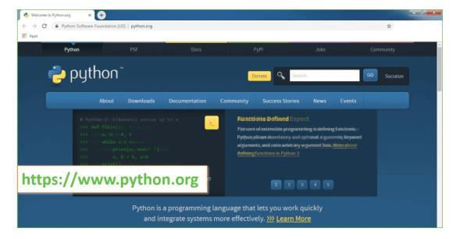
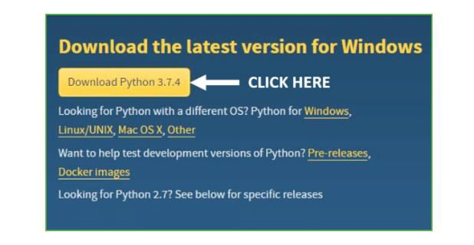
Now, check for the latest and the correct version for your operating system.
Step 2: Click on the Download Tab.
Step 3: You can either select the Download Python for windows 3.7.4 button in Yellow Color or you can scroll further down and click on download with respective to their version. Here, we are downloading the most recent python version for windows 3.7.4

Slide 27
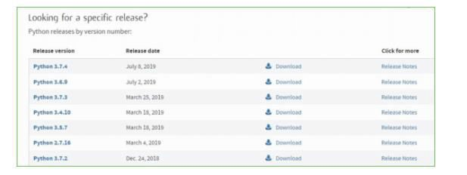
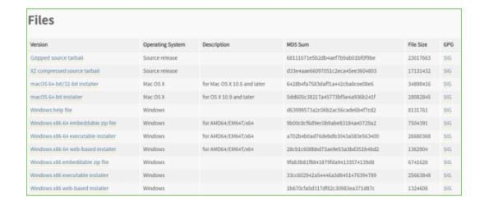
Step 4: Scroll down the page until you find the Files option.
Step 5: Here you see a different version of python along with the operating system.
To download Windows 32-bit python, you can select any one from the three options: Windows x86 embeddable zip file, Windows x86 executable installer or Windows x86 web-based installer.
To download Windows 64-bit python, you can select any one from the three options: Windows x86-64 embeddable zip file, Windows x86-64 executable installer or Windows x86-64 web-based installer.

Slide 28
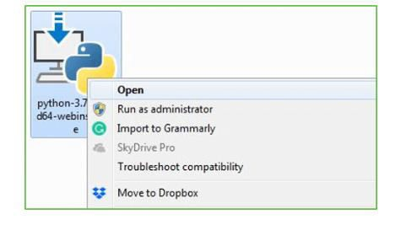
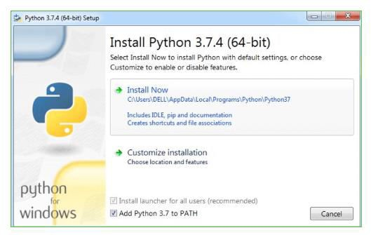
Here we will install Windows x86-64 web-based installer. Here your first part regarding which version of python is to be downloaded is completed. Now we move ahead with the second part in installing python i.e. Installation
Note: To know the changes or updates that are made in the version you can click on the Release Note Option.
Installation of Python
Step 1: Go to Download and Open the downloaded python version to carry out the installation process.
Step 2: Before you click on Install Now, Make sure to put a tick on Add Python 3.7 to PATH.

Slide 29
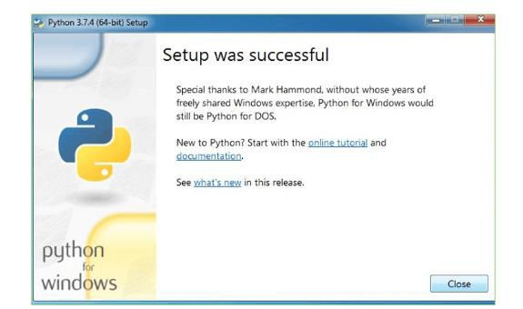
Step 3: Click on Install NOW After the installation is successful. Click on Close.
With these above three steps on python installation, you have successfully and correctly installed Python. Now is the time to verify the installation.
Note: The installation process might take a couple of minutes.
Verify the Python Installation
Step 1: Click on Start
Step 2: In the Windows Run Command, type “cmd”

Slide 30
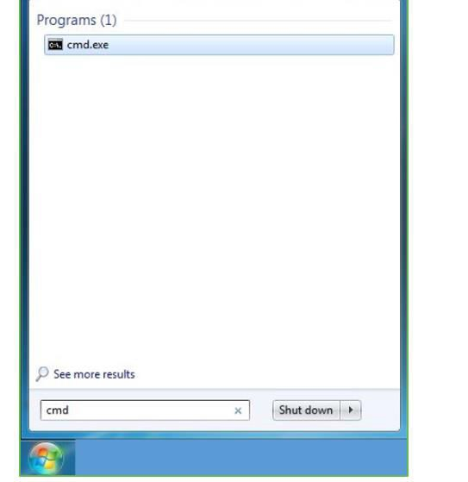
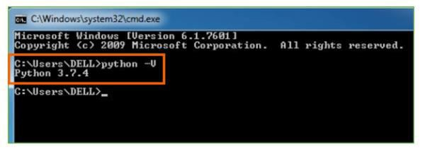
Step 3: Open the Command prompt option.
Step 4: Let us test whether the python is correctly installed. Type python –
V and press Enter.
Step 5: You will get the answer as 3.7.4
Note: If you have any of the earlier versions of Python already installed. You must first uninstall the earlier version and then install the new one.
Check how the Python IDLE works
Step 1: Click on Start
Step 2: In the Windows Run command, type “python idle”
30

Slide 31
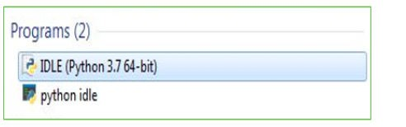
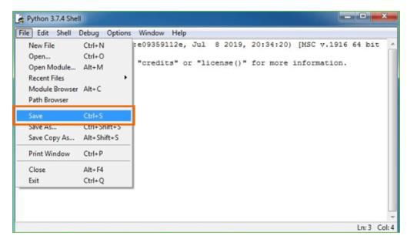
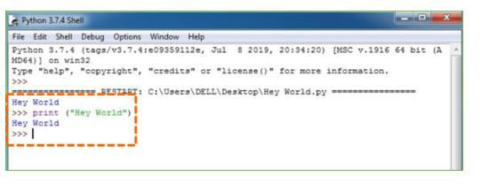
Step 3: Click on IDLE (Python 3.7 64-bit) and launch the program
Step 4: To go ahead with working in IDLE you must first save the file. Click on File > Click on Save
Step 5: Name the file and save as type should be Python files. Click on SAVE. Here I have named the files as Hey World.
Step 6: Now for e.g. enter print (“Hey World”) and Press Enter.

Slide 32
You will see that the command given is launched. With this, we end our tutorial on how to install Python. You have learned how to download python for windows into your respective operating system.
Note: Unlike Java, Python doesn’t need semicolons at the end of the statements otherwise it won’t work.
This stack that includes:
world.
Django – Design Philosophies
Django comes with the following design philosophies −
Loosely Coupled − Django aims to make each element of its stack
independent of the others.
Less Coding − Less code so in turn a quick development.
Don't Repeat Yourself (DRY) − Everything should be developed
only in exactly one place instead of repeating it again and again.
Fast Development − Django's philosophy is to do all it can to
facilitate hyper-fast development.
Clean Design − Django strictly maintains a clean design throughout
its own code and makes it easy to follow best web-development practices.
Advantages of Django
Here are few advantages of using Django which can be listed out here −
Object-Relational Mapping (ORM) Support − Django provides a bridge between the data model and the database engine, and supports a large set of database systems including MySQL, Oracle, Postgres, etc. Django also supports NoSQL database through Django-nonrel fork. For now, the only NoSQL databases supported are MongoDB and google app engine.
•
Multilingual Support − Django supports multilingual websites
through its built-in internationalization system. So you can develop your website, which would support multiple languages.

Slide 33
Framework Support − Django has built-in support for Ajax, RSS, Caching and various other frameworks.
Administration GUI − Django provides a nice ready-to-use user interface for administrative activities.
Development Environment − Django comes with a lightweight web server to facilitate end-to-end application development and testing.
As you already know, Django is a Python web framework. And like most modern framework, Django supports the MVC pattern. First let's see what is the Model-View-Controller (MVC) pattern, and then we will look at Django’s specificity for the Model-View-Template (MVT) pattern.
MVC Pattern
When talking about applications that provides UI (web or desktop), we usually talk about MVC architecture. And as the name suggests, MVC pattern is based on three components: Model, View, and Controller. Check our MVC tutorial here to know more.
Django MVC – MVT Pattern
The Model-View-Template (MVT) is slightly different from MVC. In fact the main difference between the two patterns is that Django itself takes care of the Controller part (Software Code that controls the interactions between the Model and View), leaving us with the template. The template is a HTML file mixed with Django Template Language (DTL).
The following diagram illustrates how each of the components of the MVT
pattern interacts with each other to serve a user request −

Slide 34
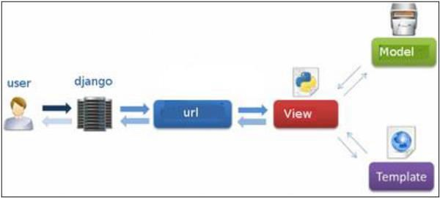
Fig 2.2: Django MVC – MVT Pattern
The developer provides the Model, the view and the template then just maps it to a URL and Django does the magic to serve it to the user.
Jupyter Notebook
The Jupyter Notebook is an open source web application that you can use to create and share documents that contain live code, equations, visualizations, and text. Jupyter Notebook is maintained by the people at Project Jupyter.
Jupyter Notebooks are a spin-off project from the IPython project, which used to have an IPython Notebook project itself. The name, Jupyter, comes from the core supported programming languages that it supports: Julia, Python, and R. Jupyter ships with the IPython kernel, which allows you to write your programs in Python, but there are currently over 100 other kernels that you can also use.

Slide 35
CHAPTER 3 SYSTEM DESIGN
3.1 Module description
Dataset Upload & Analysis: using this module we will upload dataset and then perform analysis methods such as finding various child mortality and its count and then clean dataset by removing missing values
Dataset Processing & Analytical Methods: using this module we will
encode attack labels with integer ID and then split dataset into train and test where application used 80% dataset to train classification .
Run ML Model: using this module we will trained classification algorithm with above 80% dataset and then build a prediction model
Classification Performance Graph: using this module we will plot comparison among multiple algorithms
Predict Output: using this module we will upload test dateset and then classification model will predict output based on input data
Numpy
Numpy is a general-purpose array-processing package. It provides a high- performance multidimensional array object, and tools for working with these arrays.
It is the fundamental package for scientific computing with Python. It contains various features including these important ones:
A powerful N-dimensional array object
Sophisticated (broadcasting) functions
Tools for integrating C/C++ and Fortran code
Useful linear algebra, Fourier transform, and random number capabilities
Besides its obvious scientific uses, Numpy can also be used as an efficient
multi-dimensional container of generic data. Arbitrary data-types can be defined using Numpy which allows Numpy to seamlessly and speedily integrate with a wide variety of databases.

Slide 36
Pandas
Pandas is an open-source Python Library providing high-performance data manipulation and analysis tool using its powerful data structures. Python was majorly used for data munging and preparation. It had very little contribution towards data analysis. Pandas solved this problem. Using Pandas, we can accomplish five typical steps in the processing and analysis of data, regardless of the origin of data load, prepare, manipulate, model, and analyze. Python with Pandas is used in a wide range of fields including academic and commercial domains including finance, economics, Statistics, analytics, etc.
Matplotlib
Matplotlib is a Python 2D plotting library which produces publication quality figures in a variety of hardcopy formats and interactive environments across platforms. Matplotlib can be used in Python scripts, the Python and IPython shells, the Jupyter Notebook, web application servers, and four graphical user interface toolkits. Matplotlib tries to make easy things easy and hard things possible. You can generate plots, histograms, power spectra, bar charts, error charts, scatter plots, etc., with just a few lines of code. For examples, see the sample plots and thumbnail gallery.
For simple plotting the pyplot module provides a MATLAB-like interface, particularly when combined with IPython. For the power user, you have full control of line styles, font properties, axes properties, etc, via an object oriented interface or via a set of functions familiar to MATLAB users.
Scikit – learn
Scikit-learn provides a range of supervised and unsupervised learning algorithms via a consistent interface in Python. It is licensed under a permissive simplified BSD license and is distributed under many Linux distributions, encouraging academic and commercial use. The library is built upon the SciPy (Scientific Python) that must be installed before you can use scikit-learn. This stack that includes:
•
NumPy: Base n-dimensional array package

Slide 37
•
•
•
SciPy: Fundamental library for scientific computing Matplotlib: Comprehensive 2D/3D plotting IPython: Enhanced interactive console
3.2 System Specification
3.2.1 Software Requirements
Functional requirements for a secure cloud storage service are straightforward:
The service should be able to store the user’s data;
The data should be accessible through any devices connected to the Internet;
The service should be capable to synchronize the user’s data between multiple devices (notebooks, smart phones, etc.);
The service should preserve all historical changes (versioning);
Data should be shareable with other users;
The service should support SSO; and
The service should be interoperable with other cloud storage services, enabling data migration from one CSP to another.
Operating System: Windows
Coding Language: Python 3.7
Script:
Database :
3.2.2 Hardware Requirements:
•
Processor - Pentium –III
•
Speed – 2.4 GHz

Slide 38
•
RAM - 512 MB (min)
•
Hard Disk - 20 GB
•
Floppy Drive - 1.44 MB
•
Key Board - Standard Keyboard
•
Monitor – 15 VGA Colour
Cloud computing has three fundamental models, these are:
3.3 Detailed Design
UML is an acronym that stands for Unified Modeling Language. Simply put, UML is a modern approach to modeling and documenting software. In fact, it’s one of the most popular business process modeling techniques.
It is based on diagrammatic representations of software components. As the old proverb says: “a picture is worth a thousand words”. By using visual representations, we are able to better understand possible flaws or errors in software or business processes.
UML was created as a result of the chaos revolving around software development and documentation. In the 1990s, there were several different ways to represent and document software systems. The need arose for a more unified way to visually represent those systems and as a result, in 1994-1996, the UML was developed by three software engineers working at Rational Software. It was later adopted as the standard in 1997 and has remained the standard ever since, receiving only a few updates.
GOALS:
The Primary goals in the design of the UML are as follows:
Provide users a ready-to-use, expressive visual modeling Language so that they can develop and exchange meaningful models.
Provide extendibility and specialization mechanisms to extend the core concepts.

Slide 39
Be independent of particular programming languages and development process.
Provide a formal basis for understanding the modeling language.
Encourage the growth of OO tools market.
6 Support higher level development concepts such as collaborations, frameworks, patterns and components.
7 Integrate best practices.
i. USE CASE DIAGRAM:
A use case diagram in the Unified Modeling Language (UML) is a type of behavioral diagram defined by and created from a Use-case analysis. Its purpose is to present a graphical overview of the functionality provided by a system in terms of actors, their goals (represented as use cases), and any dependencies between those use cases. The main purpose of a use case diagram is to show what system functions are performed for which actor. Roles of the actors in the system can be depicted.

Slide 40
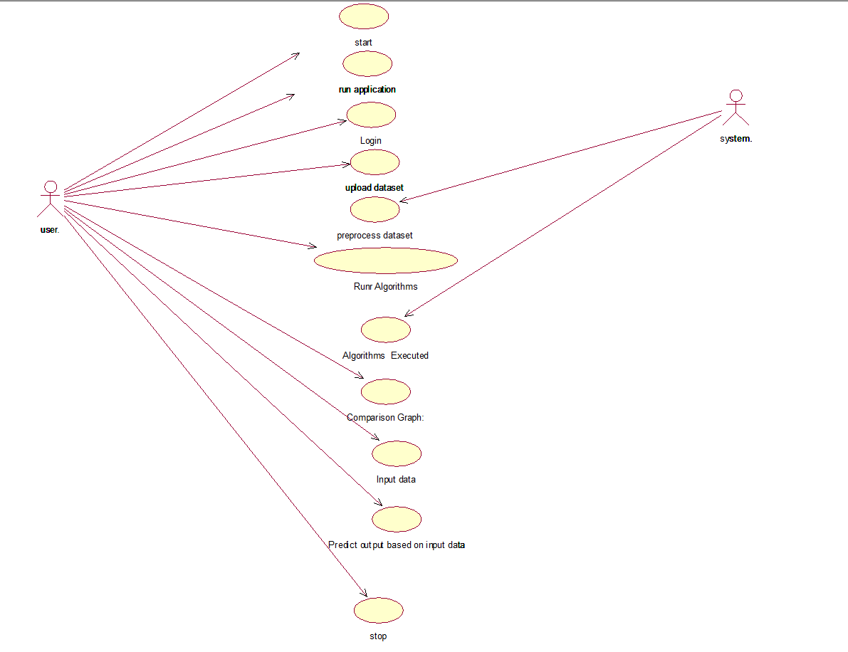
40

Slide 41
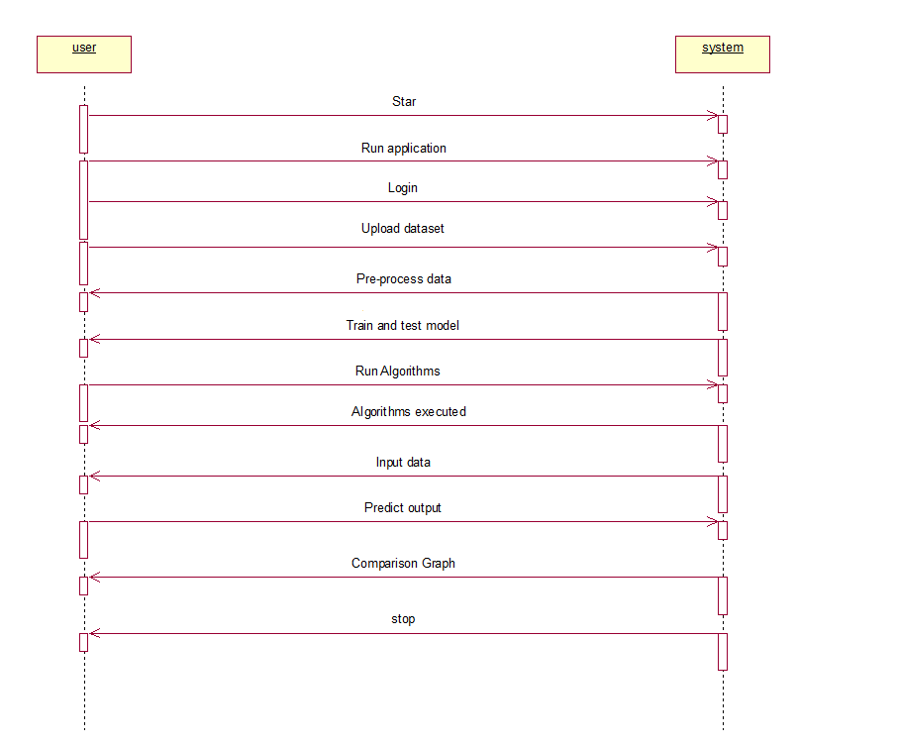
ii.SEQUENCE DIAGRAM:
A sequence diagram in Unified Modeling Language (UML) is a kind of interaction diagram that shows how processes operate with one another and in what order. It is a construct of a Message Sequence Chart. Sequence diagrams are sometimes called event diagrams, event scenarios, and timing diagrams.

Slide 42
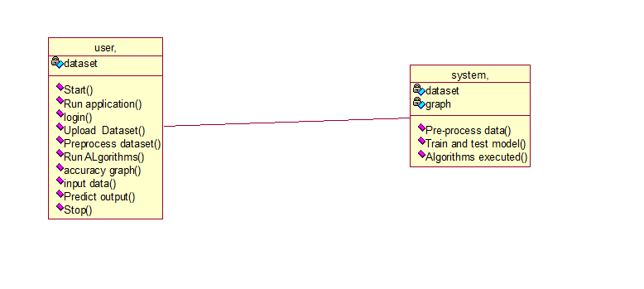
iii.CLASS DIAGRAM:
In software engineering, a class diagram in the Unified Modeling Language (UML) is a type of static structure diagram that describes the structure of a system by showing the system's classes, their attributes, operations (or methods), and the relationships among the classes. It explains which class contains information.

Slide 43
3.4ABOUT ALGORITHMS
Random Forest
Random Forest is a popular machine learning algorithm that belongs to the supervised learning technique. It can be used for both Classification and Regression problems in ML. It is based on the concept of ensemble learning, which is a process of combining multiple classifiers to solve a complex problem and to improve the performance of the model.
As the name suggests, "Random Forest is a classifier that contains a number of decision trees on various subsets of the given dataset and takes the average to improve the predictive accuracy of that dataset." Instead of relying on one decision tree, the random forest takes the prediction from each tree and based on the majority votes of predictions, and it predicts the final output.
The greater number of trees in the forest leads to higher accuracy and prevents the problem of overfitting.
The below diagram explains the working of the Random Forest algorithm:

Slide 44
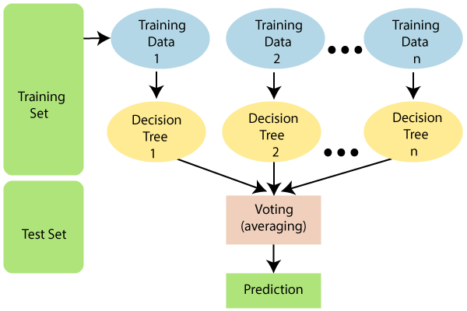
Note: To better understand the Random Forest Algorithm, you should have knowledge of the Decision Tree Algorithm.
Assumptions for Random Forest
Since the random forest combines multiple trees to predict the class of the dataset, it is possible that some decision trees may predict the correct output, while others may not. But together, all the trees predict the correct output. Therefore, below are two assumptions for a better Random forest classifier:
There should be some actual values in the feature variable of the dataset so that the classifier can predict accurate results rather than a guessed result.
The predictions from each tree must have very low correlations.
Why use Random Forest?
Below are some points that explain why we should use the Random Forest algorithm:
<="" li="">
It takes less training time as compared to other algorithms.

Slide 45
It predicts output with high accuracy, even for the large dataset it runs efficiently.
It can also maintain accuracy when a large proportion of data is missing.
How does Random Forest algorithm work?
Random Forest works in two-phase first is to create the random forest by combining N decision tree, and second is to make predictions for each tree created in the first phase.
The Working process can be explained in the below steps and diagram:
Step-1: Select random K data points from the training set.
Step-2: Build the decision trees associated with the selected data points (Subsets).
Step-3: Choose the number N for decision trees that you want to build.
Step-4: Repeat Step 1 & 2.
Step-5: For new data points, find the predictions of each decision tree, and assign the new data points to the category that wins the majority votes.
The working of the algorithm can be better understood by the below example:
Example: Suppose there is a dataset that contains multiple fruit images. So, this dataset is given to the Random forest classifier. The dataset is divided into subsets and given to each decision tree. During the training phase, each decision tree produces a prediction result, and when a new data point occurs, then based on the majority of results, the Random Forest classifier predicts the final decision. Consider the below image:

Slide 46
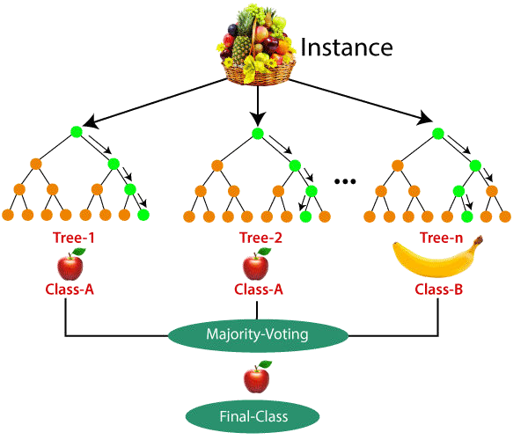
Applications of Random Forest
There are mainly four sectors where Random forest mostly used:
Banking: Banking sector mostly uses this algorithm for the identification of loan risk.
Medicine: With the help of this algorithm, disease trends and risks of the disease can be identified.
Land Use: We can identify the areas of similar land use by this algorithm.
Marketing: Marketing trends can be identified using this algorithm.
Advantages of Random Forest
o Random Forest is capable of performing both Classification and Regression tasks.

Slide 47
It is capable of handling large datasets with high dimensionality.
It enhances the accuracy of the model and prevents the overfitting issue.
Disadvantages of Random Forest
Although random forest can be used for both classification and regression tasks, it is not more suitable for Regression tasks.
Python Implementation of Random Forest Algorithm Implementation Steps are given below:
Data Pre-processing step
Fitting the Random forest algorithm to the Training set
Predicting the test result
Test accuracy of the result (Creation of Confusion matrix)
Visualizing the test set result.
Support Vector Machine
“Support Vector Machine” (SVM) is a supervised machine learning algorithm which can be used for both classification or regression challenges. However, it is mostly used in classification problems. In the SVM algorithm, we plot each data item as a point in n-dimensional space (where n is number of features you have) with the value of each feature being the value of a particular coordinate. Then, we perform classification by finding the hyper-plane that differentiates the two classes very well (look at the below snapshot).

Slide 48
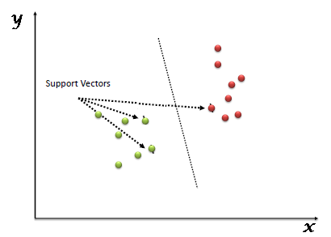
Support Vectors are simply the co-ordinates of individual observation. The SVM classifier is a frontier which best segregates the two classes (hyper-plane/ line).
The followings are important concepts in SVM −
Support Vectors − Datapoints that are closest to the hyperplane is called support vectors. Separating line will be defined with the help of these data points.
Hyperplane − As we can see in the above diagram, it is a decision plane or
space which is divided between a set of objects having different classes.
Margin − It may be defined as the gap between two lines on the closet data points of different classes. It can be calculated as the perpendicular distance from the line to the support vectors. Large margin is considered as a good margin and small margin is considered as a bad margin.
The main goal of SVM is to divide the datasets into classes to find a maximum
marginal hyperplane (MMH) and it can be done in the following two steps −
First, SVM will generate hyperplanes iteratively that segregates the classes in best way.
Then, it will choose the hyperplane that separates the classes correctly. Implementing SVM in Python
For implementing SVM in Python − We will start with the standard libraries import as follows −

Slide 49
SVM Kernels
In practice, SVM algorithm is implemented with kernel that transforms an input data space into the required form. SVM uses a technique called the kernel trick in which kernel takes a low dimensional input space and transforms it into a higher dimensional space. In simple words, kernel converts non-separable problems into separable problems by adding more dimensions to it. It makes SVM more powerful, flexible and accurate. The following are some of the types of kernels used by SVM.
Linear Kernel
It can be used as a dot product between any two observations. The formula of linear
kernel is as below −
K(x,xi)=sum(x∗xi)K(x,xi)=sum(x∗xi)
From the above formula, we can see that the product between two vectors say 𝑥 & 𝑥𝑖
is the sum of the multiplication of each pair of input values.
Polynomial Kernel
It is more generalized form of linear kernel and distinguish curved or nonlinear input space. Following is the formula for polynomial kernel −
k(X,Xi)=1+sum(X∗Xi)^dk(X,Xi)=1+sum(X∗Xi)^d
Here d is the degree of polynomial, which we need to specify manually in the learning algorithm.
Radial Basis Function (RBF) Kernel
RBF kernel, mostly used in SVM classification, maps input space in indefinite
dimensional space. Following formula explains it mathematically −
K(x,xi)=exp(−gamma∗sum(x−xi^2))K(x,xi)=exp(−gamma∗sum(x−xi^2))
Here, gamma ranges from 0 to 1. We need to manually specify it in the learning algorithm. A good default value of gamma is 0.1.
As we implemented SVM for linearly separable data, we can implement it in Python for the data that is not linearly separable. It can be done by using kernels.

Slide 50
Example
The following is an example for creating an SVM classifier by using kernels. We will be using iris dataset from scikit-learn −
We will start by importing following packages −
import pandas as pd import numpy as np
from sklearn import svm, datasets import matplotlib.pyplot as plt
Now, we need to load the input data −
iris = datasets.load_iris()
From this dataset, we are taking first two features as follows −
X = iris.data[:, :2] y = iris.target
Next, we will plot the SVM boundaries with original data as follows −
x_min, x_max = X[:, 0].min() - 1, X[:, 0].max() + 1
y_min, y_max = X[:, 1].min() - 1, X[:, 1].max() + 1 h = (x_max / x_min)/100
xx, yy = np.meshgrid(np.arange(x_min, x_max, h), np.arange(y_min, y_max, h))
X_plot = np.c_[xx.ravel(), yy.ravel()]
Now, we need to provide the value of regularization parameter as follows −
C = 1.0
Next, SVM classifier object can be created as follows −
Svc_classifier = svm.SVC(kernel='linear', C=C).fit(X, y)
Z = svc_classifier.predict(X_plot) Z = Z.reshape(xx.shape) plt.figure(figsize=(15, 5)) plt.subplot(121)
plt.contourf(xx, yy, Z, cmap=plt.cm.tab10, alpha=0.3)
50

Slide 51
plt.scatter(X[:, 0], X[:, 1], c=y, cmap=plt.cm.Set1) plt.xlabel('Sepal length')
plt.ylabel('Sepal width') plt.xlim(xx.min(), xx.max())
plt.title('Support Vector Classifier with linear kernel')
Output
Text(0.5, 1.0, 'Support Vector Classifier with linear kernel') Pros and Cons of SVM Classifiers
Pros of SVM classifiers
SVM classifiers offers great accuracy and work well with high dimensional space. SVM classifiers basically use a subset of training points hence in result uses very less memory.
Cons of SVM classifiers
They have high training time hence in practice not suitable for large datasets. Another disadvantage is that SVM classifiers do not work well with overlapping classes.
Decision Tree Classification Algorithm
Decision Tree is a Supervised learning technique that can be used for both classification and Regression problems, but mostly it is preferred for solving Classification problems. It is a tree-structured classifier, where internal nodes represent the features of a dataset, branches represent the decision rules and each leaf node represents the outcome.
In a Decision tree, there are two nodes, which are the Decision Node and Leaf Node. Decision nodes are used to make any decision and have multiple branches, whereas Leaf nodes are the output of those decisions and do not contain any further branches.
The decisions or the test are performed on the basis of features of the given dataset.

Slide 52
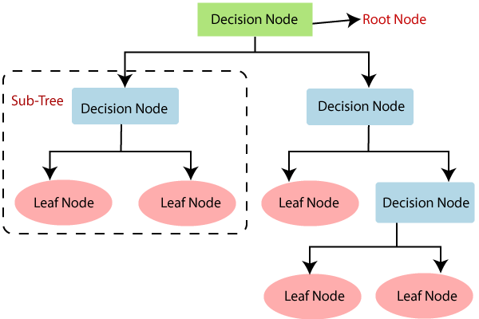
It is a graphical representation for getting all the possible solutions to a problem/decision based on given conditions.
It is called a decision tree because, similar to a tree, it starts with the root node, which expands on further branches and constructs a tree-like structure.
In order to build a tree, we use the CART algorithm, which stands for Classification and Regression Tree algorithm.
A decision tree simply asks a question, and based on the answer (Yes/No), it further split the tree into subtrees.
Below diagram explains the general structure of a decision tree:
Random Forest Algorithm
Random Forest is a popular machine learning algorithm that belongs to the supervised learning technique. It can be used for both Classification and Regression problems in ML. It is based on the concept of ensemble learning, which is a process of combining multiple classifiers to solve a complex problem and to improve the performance of the model.
As the name suggests, "Random Forest is a classifier that contains a number of decision trees on various subsets of the given dataset and takes the average to

Slide 53
improve the predictive accuracy of that dataset." Instead of relying on one decision tree, the random forest takes the prediction from each tree and based on the majority votes of predictions, and it predicts the final output.
The greater number of trees in the forest leads to higher accuracy and prevents the problem of overfitting.
CHAPTER – 4
TEST RESULTS
The purpose of testing is to discover errors. Testing is the process of trying to discover every conceivable fault or weakness in a work product. It provides a way to check the functionality of components, subassemblies, assemblies and/or a finished product It is the process of exercising software with the intent of ensuring that the

Slide 54
Software system meets its requirements and user expectations and does not fail in an unacceptable manner. There are various types of test. Each test type addresses a specific testing requirement.
TYPES OF TESTS
Unit testing
Unit testing involves the design of test cases that validate that the internal program logic is functioning properly, and that program inputs produce valid outputs. All decision branches and internal code flow should be validated. It is the testing of individual software units of the application
.it is done after the completion of an individual unit before integration. This is a structural testing, that relies on knowledge of its construction and is
invasive. Unit tests perform basic tests at component level and test a specific business process, application, and/or system configuration. Unit tests ensure
that each unique path of a business process performs accurately to the documented specifications and contains clearly defined inputs and expected
results.
Integration testing
Integration tests are designed to test integrated software components to determine if they actually run as one program. Testing is event driven and is more concerned with the basic outcome of screens or fields. Integration tests demonstrate that although the components were individually satisfaction, as shown by successfully unit testing, the combination of components is correct and consistent. Integration testing is specifically aimed at exposing the problems that arise from the combination of components.
Functional test

Slide 55
Functional tests provide systematic demonstrations that functions tested are available as specified by the business and technical requirements, system documentation, and user manuals.
Functional testing is centered on the following items:
Valid Input Input
: identified classes of valid input must be accepted. Invalid
: identified classes of invalid input must be rejected. Functions
: identified functions must be exercised.
: identified classes of application outputs must be exercised.
Output
Systems/Procedures: interfacing systems or procedures must be invoked.
Organization and preparation of functional tests is focused on requirements, key functions, or special test cases. In addition, systematic coverage pertaining to identify Business process flows; data fields, predefined processes, and successive processes must be considered for testing. Before functional testing is complete, additional tests are identified and the effective value of current tests is determined.
System Test
System testing ensures that the entire integrated software system meets requirements. It tests a configuration to ensure known and predictable results. An example of system testing is the configuration oriented system integration test. System testing is based on process descriptions and flows, emphasizing pre-driven process links and integration points.
White Box Testing
White Box Testing is a testing in which in which the software tester has knowledge of the inner workings, structure and language of the software, or at least its purpose. It is purpose. It is used to test areas that cannot be reached from a black box level.

Slide 56
Black Box Testing
Black Box Testing is testing the software without any knowledge of the inner workings, structure or language of the module being tested. Black box tests, as most other kinds of tests, must be written from a definitive source document, such as specification or requirements document, such as specification or requirements document. It is a testing in which the software under test is treated, as a black box .you cannot ―see‖ into it. The test provides inputs and responds to outputs without considering how the software works.
5.1 Unit Testing:
Unit testing is usually conducted as part of a combined code and unit test phase of the software lifecycle, although it is not uncommon for coding and unit testing to be conducted as two distinct phases.
Test strategy and approach
Field testing will be performed manually and functional tests will be written in detail.
Test objectives
•
All field entries must work properly.
•
Pages must be activated from the identified link.
•
The entry screen, messages and responses must not be delayed.
Features to be tested
•
Verify that the entries are of the correct format
•
No duplicate entries should be allowed
•
All links should take the user to the correct page.

Slide 57
5.2 Integration Testing
Software integration testing is the incremental integration testing of two or more integrated software components on a single platform to produce failures caused by interface defects.
The task of the integration test is to check that components or software applications, e.g. components in a software system or – one step up – software applications at the company level – interact without error.
Test Results: All the test cases mentioned above passed successfully. No defects encountered.
5.3 Acceptance Testing
User Acceptance Testing is a critical phase of any project and requires significant participation by the end user. It also ensures that the system meets the functional requirements.
Test Results: All the test cases mentioned above passed successfully. No defects encountered.
5.4 CODE

Slide 58
from django.shortcuts import render import pymysql
import os import pandas as pd
from sklearn.model_selection import train_test_split
from sklearn.ensemble import RandomForestClassifier from sklearn.metrics import accuracy_score
from sklearn import svm
from sklearn.tree import DecisionTreeClassifier import numpy as np
import matplotlib.pyplot as plt
# Create your views here. def index(request):
return render(request,'AdminApp/index.html') def login(request):
return render(request,'AdminApp/Admin.html')
def LogAction(request):
username=request.POST.get('username') password=request.POST.get('password')
con=pymysql.connect(host="localhost",user="root",passwor d="root",database="child")
cur=con.cursor() cur.execute("select * from admin where

Slide 59
username='"+username+"'and password='"+password+"'")
data=cur.fetchone() if data is not None:
return render(request,'AdminApp/AdminHome.html')
else: context={'data':'Login Failed ....!!'}
return render(request,'AdminApp/Admin.html',context) def home(request):
return render(request,'AdminApp/AdminHome.html')
global data
def LoadData(request):
global data BASE_DIR =
os.path.dirname(os.path.dirname(os.path.abspath( file )))
data=pd.read_excel(BASE_DIR+"\\dataset\\data.csv") data.fillna(0, inplace=True)
context={'data':"Dataset Loaded\n"}
return render(request,'AdminApp/LoadDataset.html',context)
global X global y
global X_train,X_test,y_train,y_test def split(request):
if data is not None:

Slide 60
global X global y
global X_train,X_test,y_train,y_test X=data[['age','gendera','BMI','hypertensive','heart
rate','diabetes']]
y=data[['outcome']] X_train,X_test,y_train,y_test=train_test_split(X,y,
test_size=0.3)
table="<table border='1' style='margin- top:100px;'><tr><th>Total Dataset Records</th><th>70%
records as training data</th><th>30% records as test data</th></tr>"
table+="<tr><td>"+str(len(data))+"</td><td>"+str(len(X_tr ain))+"</td><td>"+str(len(y_test))+"</td></tr>"
table+="</table>" context={"data":table}
return render(request,'AdminApp/DataSlipt.html',context)
else: context={"data":"please Load Dataset First"}
return render(request,'AdminApp/DataSlipt.html',context)
global rfc_accurary global rfc
def RandomForest(request):
60

Slide 61
global rfc_accurary global rfc
rfc = RandomForestClassifier(n_estimators=20, random_state=0)
rfc.fit(X_train, y_train) prediction=rfc.predict(X_test)
acc=accuracy_score(prediction,y_test) rfc_accurary=acc*100 context={"data":rfc_accurary} return
render(request,'AdminApp/RandomForest.html',context)
global dec_accurary global dec
def DecisionTrees(request): global dec_accurary
global dec
dec = DecisionTreeClassifier() dec.fit(X_train, y_train) prediction=dec.predict(X_test)
acc=accuracy_score(prediction,y_test) dec_accurary=acc*100 context={"data":dec_accurary} return
render(request,'AdminApp/DecisionTree.html',context)
global svm_accurary

Slide 62
global model
def SupportVectorClassifiers(request): global svm_accurary
global model
model = svm.SVC()
model.fit(X_train, y_train) prediction=model.predict(X_test) acc=accuracy_score(prediction,y_test) svm_accurary=acc*100 context={"data":svm_accurary} return
render(request,'AdminApp/SupportVM.html',context)
global rfc_accurary,dec_accurary,svm_accurary def Comparision(request):
global rfc_accurary,dec_accurary,svm_accurary bars = ['RandomForest Accuracy','Decision
Accurary','Support Vector Accurary']
height = [rfc_accurary,dec_accurary, svm_accurary] y_pos = np.arange(len(bars))
plt.bar(y_pos, height) plt.xticks(y_pos, bars) plt.show()
fig = plt.figure(figsize =(8, 5)) plt.pie(height, labels =bars )

Slide 63
plt.show()
return render(request,'AdminApp/Prediction.html') def PredictMortality(request):
return render(request,'AdminApp/Prediction.html')
def PredAction(request):
global dec age=request.POST.get('age') gender=request.POST.get('gender')
bmi=request.POST.get('bmi') hyper=request.POST.get('hyper') diabetes=request.POST.get('diabetes') hartrate=request.POST.get('hartrate') a=int(age)
g=int(gender)
b=float(bmi) h=int(hyper) d=int(diabetes) hr=float(hartrate)
pred=dec.predict([[a,g,b,h,hr,d]]) print("predicted value: "+str(pred)) if pred[0]==1:
context={'data':'Child Mortality Predicted as :: Yes'} return

Slide 64
render(request,'AdminApp/PredictedData.html',context)
elif pred[0]==0: context={'data':'Child Mortality Predicted as :: No'}
return render(request,'AdminApp/PredictedData.html',context)
<!DOCTYPE html>
{% load static %}
<html lang="en">
<head>
<!-- Basic -->
<meta charset="utf-8" />
<meta http-equiv="X-UA-Compatible" content="IE=edge"
/>
<!-- Mobile Metas -->
<meta name="viewport" content="width=device-width, initial-scale=1, shrink-to-fit=no" />
<!-- Site Metas -->
<meta name="keywords" content="" />
<meta name="description" content="" />
<meta name="author" content="" />
<title>Child Mortality</title>

Slide 65
<!-- slider stylesheet -->
<link rel="stylesheet" type="text/css" href="{%static 'https://cdnjs.cloudflare.com/ajax/libs/OwlCarousel2/2.1.3/as sets/owl.carousel.min.css'%}" />
<!-- bootstrap core css -->
<link rel="stylesheet" type="text/css" href="{%static 'css/bootstrap.css'%}" />
<!-- fonts style -->
<link href="{%static 'https://fonts.googleapis.com/css?family=Lato:400,700|Poppin s:400,700|Roboto:400,700&display=swap'%}" rel="stylesheet" />
<!-- Custom styles for this template -->
<link href="{%static 'css/style.css'%}" rel="stylesheet" />
<!-- responsive style -->
<link href="{%static 'css/responsive.css'%}" rel="stylesheet" />
</head>
<body>
<div class="hero_area">
<!-- header section strats -->

Slide 66
<header class="header_section">
<div class="container">
<nav class="navbar navbar-expand-lg custom_nav-
container ">
<a class="navbar-brand" href="index.html">
<img src="images/logo.png" alt="" />
<span>
</span>
</a>
<button class="navbar-toggler" type="button" data- toggle="collapse" data-target="#navbarSupportedContent"
aria-controls="navbarSupportedContent" aria- expanded="false" aria-label="Toggle navigation">
<span class="navbar-toggler-icon"></span>
</button>
<div class="collapse navbar-collapse" id="navbarSupportedContent">
<div class="d-flex ml-auto flex-column flex-lg-row align-items-center">
<ul class="navbar-nav ">
<li class="nav-item ">
<a class="nav-link" href="/load"> Load Dataset
</a>

Slide 67
</li>
<li class="nav-item ">
<a class="nav-link" href="/split"> Preprocess & Slipt </a>
</li>
<li class="nav-item ">
<a class="nav-link" href="/RandomForest"> RandomForest </a>
</li>
<li class="nav-item ">
<a class="nav-link" href="/DecisionTrees"> DecisionTree</a>
</li>
<li class="nav-item ">
<a class="nav-link" href="/SupportVectorClassifiers">Run SVC </a>
</li>
<li class="nav-item ">
<a class="nav-link" href="/Comparision"> Comparision </a>
</li>
<li class="nav-item active">
<a class="nav-link" href="/PredictMortality">Predict </a>
</li>

Slide 68
<li class="nav-item">
<a class="nav-link" href="/Admin"> Logout </a>
</li>
</ul>
</div>
</div>
</nav>
</div>
</header>
<!-- end header section -->
<!-- slider section -->
<section class=" slider_section position-relative">
<div class="container">
<div id="carouselExampleIndicators" class="carousel slide" data-ride="carousel">
<div class="carousel-inner">
<div class="carousel-item active">
<div class="row">
<div class="col-md-6">
<div class="detail-box">
<h1>
<br />
<span>

Slide 69
Child Mortality Prediction
</span>
</h1>
</div>
</div>
</div>
</div>
</div>
</section>
<!-- end slider section -->
</div>
<!-- client section -->

Slide 70
<section class="client_section layout_padding">
<div class="container layout_padding2-top">
<div class="heading_container">
<h2>
</h2>
</div>
<div id="carouselExampleControls" class="carousel slide" data-ride="carousel">
<div class="carousel-inner">
<div class="carousel-item active">
<div class="client_container layout_padding">
<font color="blue" size="8">{{data}}</font>
</div>
</div>
</div>
70

Slide 71
</div>
</section>
<!-- end client section -->
<!-- footer section -->
<section class="container-fluid footer_section">
<p>
&copy; 2023 All Rights Reserved By
<a href="https://html.design/">Child Mortality</a>
</p>
</section>
<!-- footer section -->
<script type="text/javascript" src="{%static 'js/jquery- 3.4.1.min.js'%}"></script>
<script type="text/javascript" src="{%static 'js/bootstrap.js'%}"></script>
<script>
// This example adds a marker to indicate the position of Bondi Beach in Sydney,
// Australia.

Slide 72
function initMap() { var map = new
google.maps.Map(document.getElementById("map"), {
zoom: 11, center: {
lat: 40.645037,
lng: -73.880224
}
});
var image = "images/maps-and-flags.png"; var beachMarker = new google.maps.Marker({ position: {
lat: 40.645037,
lng: -73.880224
},
map: map, icon: image
});
}
</script>
</body>
</html>

Slide 73
<!DOCTYPE html>
{% load static %}
<html lang="en">
<head>
<!-- Basic -->
<meta charset="utf-8" />
<meta http-equiv="X-UA-Compatible" content="IE=edge"
/>
<!-- Mobile Metas -->
<meta name="viewport" content="width=device-width, initial-scale=1, shrink-to-fit=no" />
<!-- Site Metas -->
<meta name="keywords" content="" />
<meta name="description" content="" />
<meta name="author" content="" />
<title>Child Mortality</title>
<!-- slider stylesheet -->
<link rel="stylesheet" type="text/css" href="{%static 'https://cdnjs.cloudflare.com/ajax/libs/OwlCarousel2/2.1.3/as sets/owl.carousel.min.css'%}" />

Slide 74
<!-- bootstrap core css -->
<link rel="stylesheet" type="text/css" href="{%static 'css/bootstrap.css'%}" />
<!-- fonts style -->
<link href="{%static 'https://fonts.googleapis.com/css?family=Lato:400,700|Poppin s:400,700|Roboto:400,700&display=swap'%}" rel="stylesheet" />
<!-- Custom styles for this template -->
<link href="{%static 'css/style.css'%}" rel="stylesheet" />
<!-- responsive style -->
<link href="{%static 'css/responsive.css'%}" rel="stylesheet" />
</head>
<body>
<div class="hero_area">
<!-- header section strats -->
<header class="header_section">
<div class="container">
<nav class="navbar navbar-expand-lg custom_nav-
container ">
<a class="navbar-brand" href="index.html">
<img src="images/logo.png" alt="" />

Slide 75
<span>
</span>
</a>
<button class="navbar-toggler" type="button" data- toggle="collapse" data-target="#navbarSupportedContent"
aria-controls="navbarSupportedContent" aria- expanded="false" aria-label="Toggle navigation">
<span class="navbar-toggler-icon"></span>
</button>
<div class="collapse navbar-collapse" id="navbarSupportedContent">
<div class="d-flex ml-auto flex-column flex-lg-row align-items-center">
<ul class="navbar-nav ">
<li class="nav-item ">
<a class="nav-link" href="/load"> Load Dataset
</a>
</li>
<li class="nav-item ">
<a class="nav-link" href="/split"> Preprocess & Split </a>
</li>
<li class="nav-item ">
<a class="nav-link" href="/RandomForest">

Slide 76
RandomForest </a>
</li>
<li class="nav-item active">
<a class="nav-link" href="/DecisionTrees"> DecisionTree</a>
</li>
<li class="nav-item ">
<a class="nav-link" href="/SupportVectorClassifiers"> Run SVC </a>
</li>
<li class="nav-item ">
<a class="nav-link" href="/Comparision"> Comparision </a>
</li>
<li class="nav-item ">
<a class="nav-link" href="/PredictMortality">Predict </a>
</li>
<li class="nav-item">
<a class="nav-link" href="/Admin"> Logout </a>
</li>
</ul>
</div>
</div>

Slide 77
</nav>
</div>
</header>
<!-- end header section -->
<!-- slider section -->
<section class=" slider_section position-relative">
<div class="container">
<div id="carouselExampleIndicators" class="carousel slide" data-ride="carousel">
<div class="carousel-inner">
<div class="carousel-item active">
<div class="row">
<div class="col-md-6">
<div class="detail-box">
<h1>
<br />
<span>
Child Mortality Prediction
</span>
</h1>
</div>

Slide 78
</div>
</div>
</div>
</div>
</section>
<!-- end slider section -->
</div>
<!-- client section -->
<section class="client_section layout_padding">
<div class="container layout_padding2-top">
<div class="heading_container">
<h2>
</h2>
</div>
<div id="carouselExampleControls" class="carousel

Slide 79
slide" data-ride="carousel">
<div class="carousel-inner">
<div class="carousel-item active">
<div class="client_container layout_padding">
<font color="green" size="8">Decision Tree Prediction
Accuracy</font>
<font color="green" size="6">{{data}}</font>
</div>
</div>
</div>
</div>
</section>

Slide 80
<!-- end client section -->
<!-- footer section -->
<section class="container-fluid footer_section">
<p>
&copy; 2023 All Rights Reserved By
<a href="https://html.design/">Child Mortality</a>
</p>
</section>
<!-- footer section -->
<script type="text/javascript" src="{%static 'js/jquery- 3.4.1.min.js'%}"></script>
<script type="text/javascript" src="{%static 'js/bootstrap.js'%}"></script>
<script>
// This example adds a marker to indicate the position of Bondi Beach in Sydney,
// Australia. function initMap() { var map = new
80

Slide 81
google.maps.Map(document.getElementById("map"), {
zoom: 11, center: {
lat: 40.645037,
lng: -73.880224
}
});
var image = "images/maps-and-flags.png"; var beachMarker = new google.maps.Marker({ position: {
lat: 40.645037,
lng: -73.880224
},
map: map, icon: image
});
}
</script>
</body>
</html>
<!DOCTYPE html>

Slide 82
{% load static %}
<html lang="en">
<head>
<!-- Basic -->
<meta charset="utf-8" />
<meta http-equiv="X-UA-Compatible" content="IE=edge"
/>
<!-- Mobile Metas -->
<meta name="viewport" content="width=device-width, initial-scale=1, shrink-to-fit=no" />
<!-- Site Metas -->
<meta name="keywords" content="" />
<meta name="description" content="" />
<meta name="author" content="" />
<title>Child Mortality</title>
<!-- slider stylesheet -->
<link rel="stylesheet" type="text/css" href="{%static 'https://cdnjs.cloudflare.com/ajax/libs/OwlCarousel2/2.1.3/as sets/owl.carousel.min.css'%}" />
<!-- bootstrap core css -->
<link rel="stylesheet" type="text/css" href="{%static 'css/bootstrap.css'%}" />

Slide 83
<!-- fonts style -->
<link href="{%static 'https://fonts.googleapis.com/css?family=Lato:400,700|Poppin s:400,700|Roboto:400,700&display=swap'%}" rel="stylesheet" />
<!-- Custom styles for this template -->
<link href="{%static 'css/style.css'%}" rel="stylesheet" />
<!-- responsive style -->
<link href="{%static 'css/responsive.css'%}" rel="stylesheet" />
</head>
<body>
<div class="hero_area">
<!-- header section strats -->
<header class="header_section">
<div class="container">
<nav class="navbar navbar-expand-lg custom_nav-
container ">
<a class="navbar-brand" href="index.html">
<img src="images/logo.png" alt="" />
<span>
</span>

Slide 84
</a>
<button class="navbar-toggler" type="button" data- toggle="collapse" data-target="#navbarSupportedContent"
aria-controls="navbarSupportedContent" aria- expanded="false" aria-label="Toggle navigation">
<span class="navbar-toggler-icon"></span>
</button>
<div class="collapse navbar-collapse" id="navbarSupportedContent">
<div class="d-flex ml-auto flex-column flex-lg-row align-items-center">
<ul class="navbar-nav ">
<li class="nav-item ">
<a class="nav-link" href="/load"> Load Dataset
</a>
</li>
<li class="nav-item ">
<a class="nav-link" href="/split"> Preprocess & Split </a>
</li>
<li class="nav-item ">
<a class="nav-link" href="/RandomForest"> RandomForest </a>
</li>
<li class="nav-item active">

Slide 85
<a class="nav-link" href="/DecisionTrees"> DecisionTree</a>
</li>
<li class="nav-item ">
<a class="nav-link" href="/SupportVectorClassifiers"> Run SVC </a>
</li>
<li class="nav-item ">
<a class="nav-link" href="/Comparision"> Comparision </a>
</li>
<li class="nav-item ">
<a class="nav-link" href="/PredictMortality">Predict </a>
</li>
<li class="nav-item">
<a class="nav-link" href="/Admin"> Logout </a>
</li>
</ul>
</div>
</div>
</nav>
</div>
</header>

Slide 86
<!-- end header section -->
<!-- slider section -->
<section class=" slider_section position-relative">
<div class="container">
<div id="carouselExampleIndicators" class="carousel slide" data-ride="carousel">
<div class="carousel-inner">
<div class="carousel-item active">
<div class="row">
<div class="col-md-6">
<div class="detail-box">
<h1>
<br />
<span>
Child Mortality Prediction
</span>
</h1>
</div>
</div>
</div>
</div>

Slide 87
</div>
</section>
<!-- end slider section -->
</div>
<!-- client section -->
<section class="client_section layout_padding">
<div class="container layout_padding2-top">
<div class="heading_container">
<h2>
</h2>
</div>
<div id="carouselExampleControls" class="carousel slide" data-ride="carousel">
<div class="carousel-inner">
<div class="carousel-item active">

Slide 88
<div class="client_container layout_padding">
<font color="green" size="8">Decision Tree Prediction
Accuracy</font>
<font color="green" size="6">{{data}}</font>
</div>
</div>
</div>
</div>
</section>
<!-- end client section -->

Slide 89
<!-- footer section -->
<section class="container-fluid footer_section">
<p>
&copy; 2023 All Rights Reserved By
<a href="https://html.design/">Child Mortality</a>
</p>
</section>
<!-- footer section -->
<script type="text/javascript" src="{%static 'js/jquery- 3.4.1.min.js'%}"></script>
<script type="text/javascript" src="{%static 'js/bootstrap.js'%}"></script>
<script>
// This example adds a marker to indicate the position of Bondi Beach in Sydney,
// Australia. function initMap() { var map = new
google.maps.Map(document.getElementById("map"), {
zoom: 11, center: {

Slide 90
lat: 40.645037,
lng: -73.880224
}
});
var image = "images/maps-and-flags.png"; var beachMarker = new google.maps.Marker({ position: {
lat: 40.645037,
lng: -73.880224
},
map: map, icon: image
});
}
</script>
</body>
</html>
90

Slide 91


CHAPTER 6 RESULTS
INDEX PAGE
ADMIN LOGIN PAGE
Admin home page

Slide 92

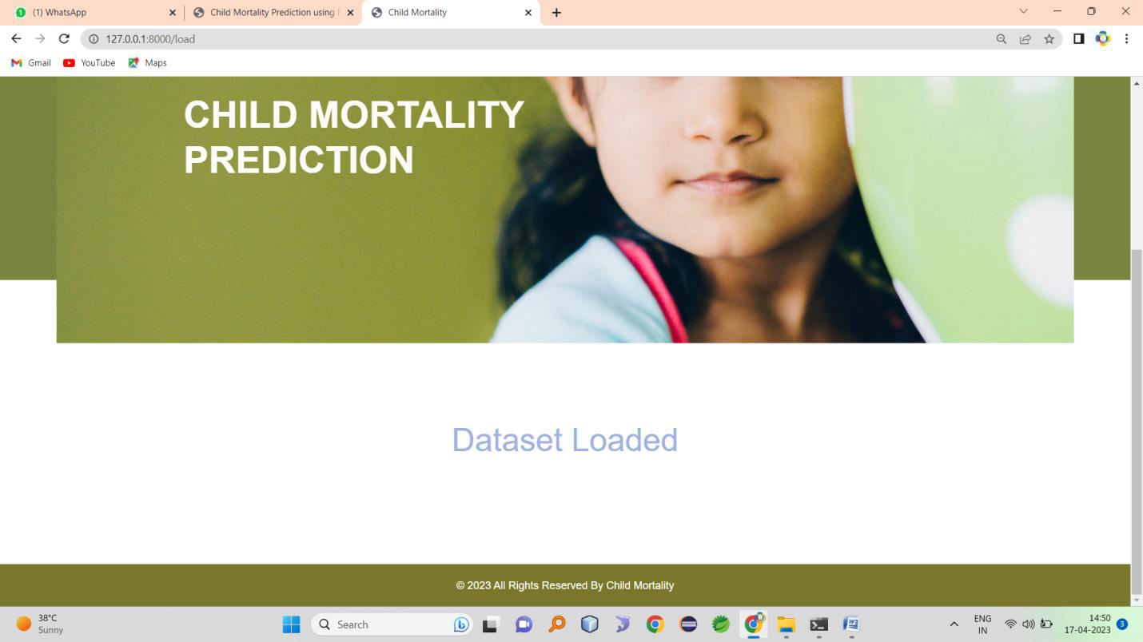
Data set loaded
Dataset pre-processed and splited

Slide 93
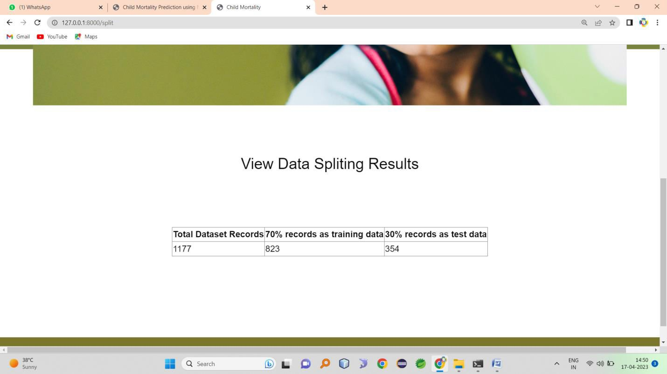
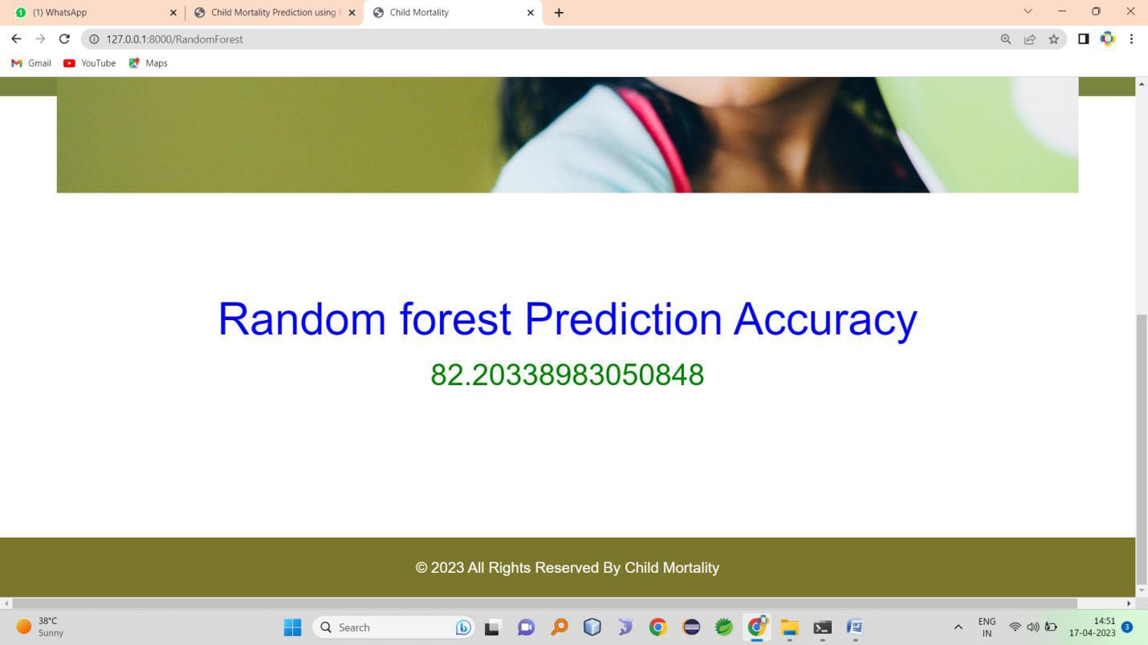
Random forest algorithm accuracy
Decision tree accuracy

Slide 94
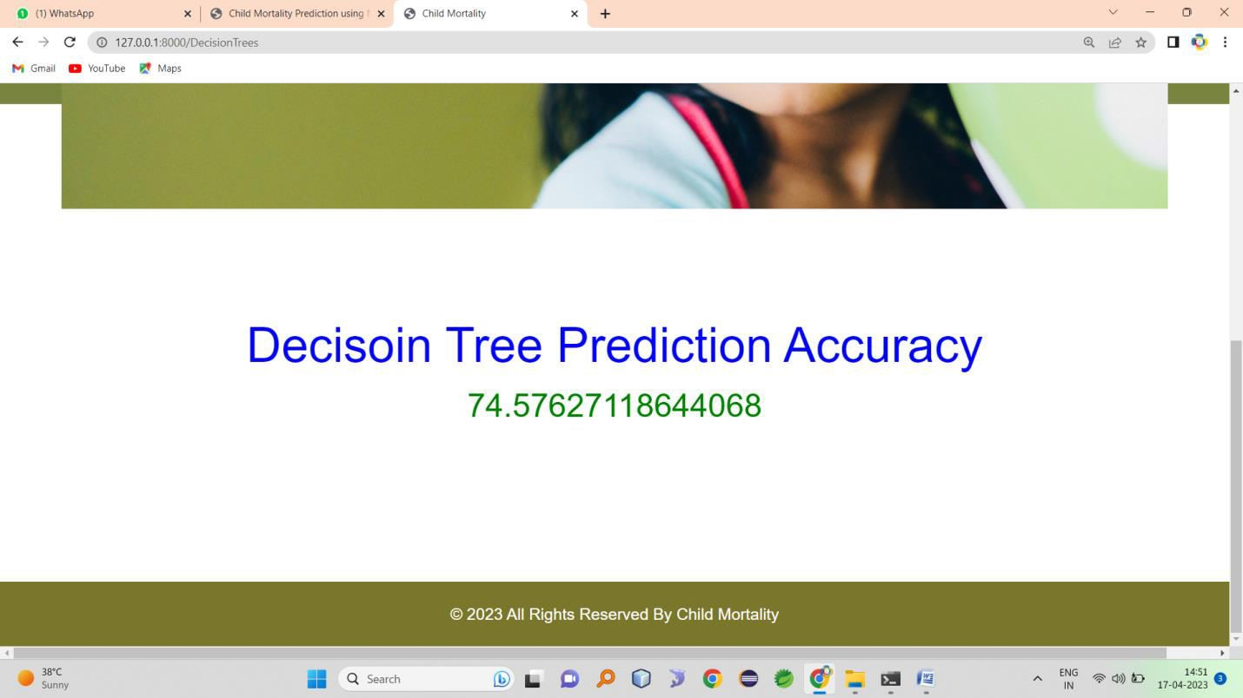

Support vector classifier
Comparison graph

Slide 95
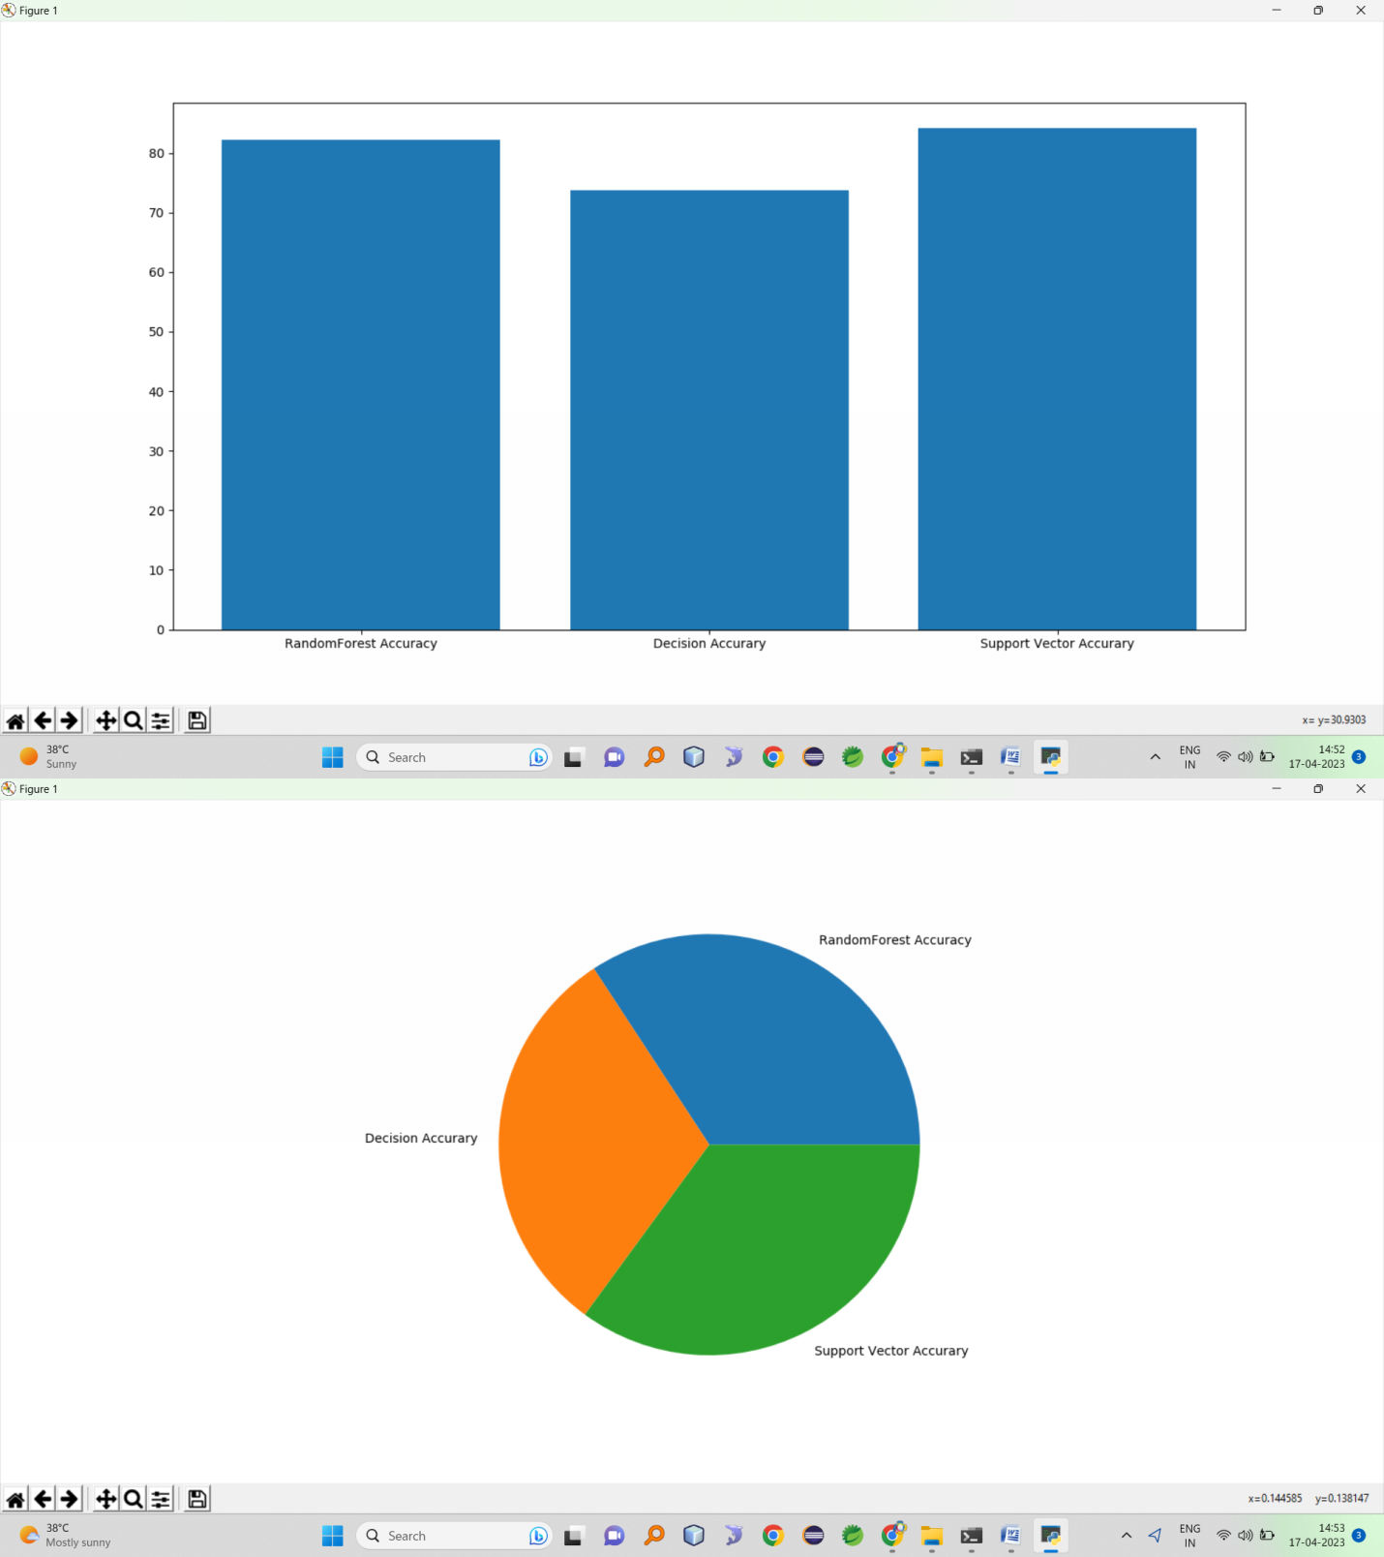
Prediction

Slide 96
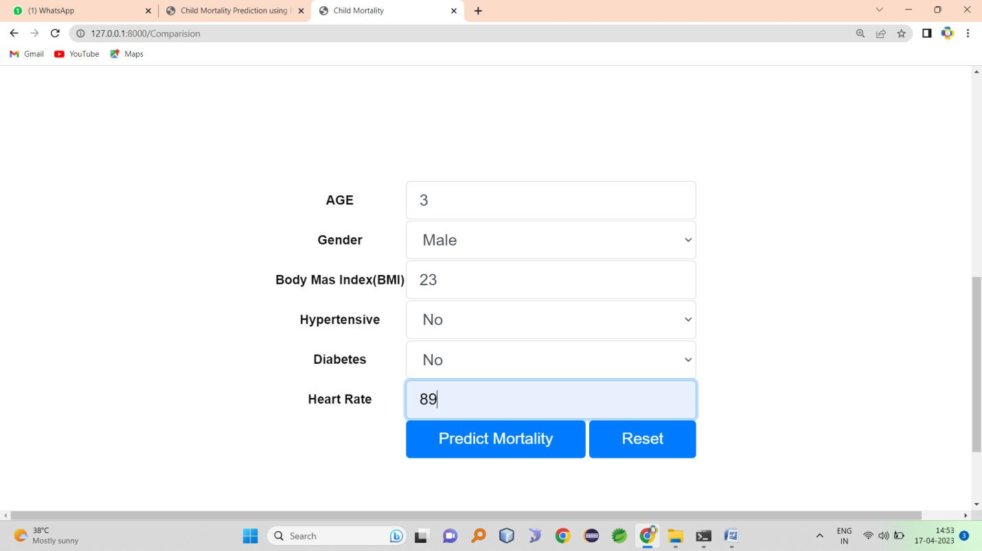
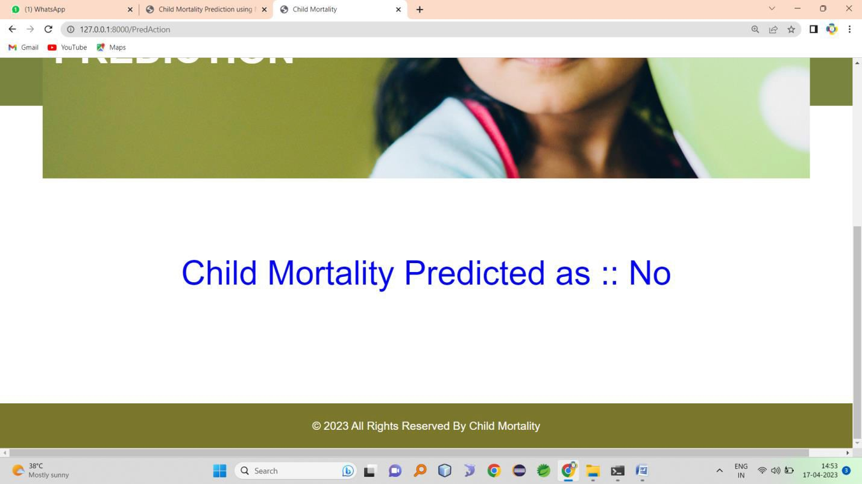
result
Second case

Slide 97
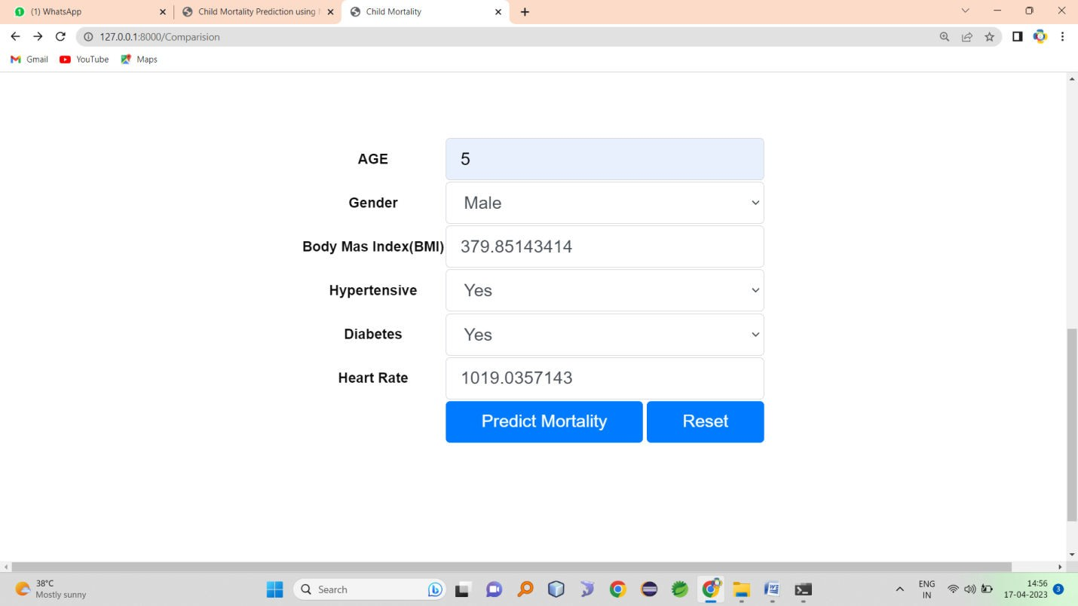
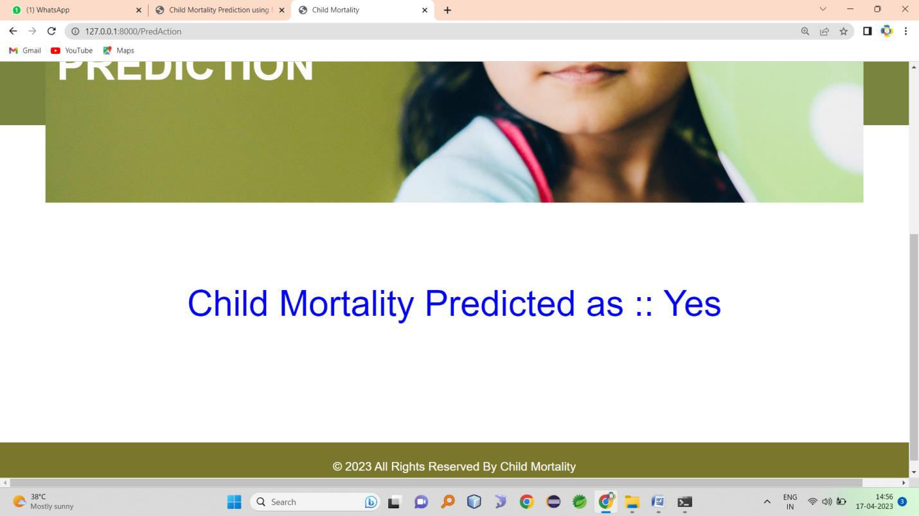
Result
Add three or four screen shots here

Slide 98
CONCLUSION & FUTURE WORK CONCLUSION
In this study, we explored the use of Random Forest, Decision
Trees, and Support Vector Machines (SVM) for predicting child mortality. We used a dataset that contained various socio- economic and health indicators from different countries to train
and evaluate the models.
Based on our experiments, we found that Random Forest achieved the highest accuracy in predicting child mortality, followed by Decision Trees and SVM. Random Forest is known for its ability to handle high-dimensional datasets and capture complex relationships between variables, which likely contributed to its superior performance in this case. Decision Trees also performed well, but they tend to be more prone to overfitting compared to Random Forest. SVM had the Highest accuracy, indicating that it may not be the most suitable algorithm for this specific prediction task.
Future Scope:
Although Random Forest yielded the best results in this study, there are still opportunities for further improvement and exploration. Here are some potential future directions:
Feature engineering: The selection and creation of relevant features can significantly impact the performance of machine learning models. Exploring additional socio-economic and health indicators, or deriving new features from the existing ones, may enhance the accuracy of child mortality

Slide 99
prediction.
Ensemble methods: While Random Forest is already an ensemble method, combining multiple models or using advanced ensemble techniques like gradient boosting could potentially improve prediction accuracy further.
Deep learning approaches: Deep learning algorithms, such as neural networks, have shown remarkable performance in various domains. Applying deep learning models to child mortality prediction may lead to better results by automatically learning complex patterns and representations from the data.
Temporal analysis: Child mortality rates may vary over time due to changing socio-economic conditions and healthcare interventions. Incorporating temporal analysis techniques, such as time series analysis or recurrent neural networks, could provide insights into predicting child mortality in different time periods.
Interpretability: While Random Forest and Decision Trees offer some level of interpretability, SVM and deep learning models are often considered black boxes. Developing methods to interpret and explain the predictions of these models can help understand the underlying factors influencing child mortality.
REFERENCES
[1] Las Johansen B. Caluza, ‘‘Man-made brainpower Algorithm Application

Slide 100
in Predicting Children Mortality: A Model Development’‘, International
Journal of Information Sciences and Application, ISSN 0974-2255 Volume
10, Number 1 (2018).
[2] Viji Amutha Mary, et.al, “ Securing data by detecting multichannel attacks
using deep learning, June 2021, doi:10.1109/icoei51242.2021.9452921,
conference: 2021 5th international conference on trends in electronics and
informatics (icoei)
[3] Fikrewold H. Bitew, Samuel H. Nyarko, Lloyd Potter and Corey S. Streaks, ‘‘PC based insight approach for expecting under-five mortality
determinants in Ethiopia: affirmation from the 2016 Ethiopian Demographic
and Health Survey’‘, Published: 04 November 2020.
[4] Cheyenne Mangold, Sarah Zoretic, Keerthi Thallapureddy, Axel Moreira,
Kevin Chorath, Alvaro Moreira, ‘‘Mimicked insight Models for Predicting
Neonatal Mortality: A Systematic Review’‘, https://doi.org/10.3389/fped.2021.644922.
[5] Adeyinka Emmanuel Adegbosin, Bela Stantic, Jing Sun,
‘‘Sufficiency of
significant learning techniques for expecting under-five mortality in 34 lowpay and focus pay countries’‘.
10

Slide 101
[6] Chodziwadziwa Kabudula, Reesha Kara, Henry Wandera, Fidelia A. A.
Dake, Justin Dansou, Dereje Danbe Debeko, Chipo Mufudza,
‘‘Appraisal of
AI techniques for expecting the risk of child mortality in South Africa’‘.https://doi.org/10.1177/1550147720928897
[7] Rushikesh Gawande, Shreiya Indulkar, Himani Keswani, Malvika Khatri,
Pallavi Saindane, ‘‘Appraisal and Prediction of Child Mortality in India’‘, eISSN: 2395-0056, p-ISSN: 2395-0072, Volume: 06 Issue: 03 |
Mar 2019.
[8] Dr. Smartson. P. NYONI, Thabani NYONI, ‘‘Assumption for Infant
Mortality Rate in India Using a Machine Learning Technique’‘, ISSN (on the
web): 2581-3048 Volume 5, Issue 3, pp 637-641, March2021,https://doi.org/10.47001/IRJIET/2021.503110.
[9] Dweepobotee Brahma, Debasri Mukherjee, ‘‘Early counsel signs: zeroing in
on neonatal and child mortality using machine learning’‘,https://doi.org/10.1080/00036846.2021.1958141.
[10] Wang, T., S. Zhao, G. Zhu, and H. Zheng. 2021. “A Machine Learningbased Early Warning System for Systemic Banking Crises.” Applied
Economics 53(26): 2974–2992, doi:https://doi.org/10.1080/00036846.2020.1870657
10

Slide 102
[11] Gonzalez, R. M., and D. Gilleskie. 2017. “Infant Mortality Rate as A
Measure of A Country’s Health: A Robust Method to Improve Reliability and
Comparability.” Demography 54(2): 701–720. doi:https://doi.org/10.1007/s13524-017-0553-7.
[12] Bhargava, A. 2003. “Family Planning, Gender Differences and Infant
Mortality: Evidence from Uttar Pradesh, India.” Journal of Econometrics 112
(1): 225–240. doi:https://doi.org/10.1016/S0304-4076(02)00162-8.
[13] Bhalotra, S. 2007. “Spending to Save? State Health Expenditure and Infant
Mortality in India.” Health Economics 16 (9): 911–928. doi:https://doi.org/10.1002/hec.1260.
[14] Debnath, S. 2019. “Improving Maternal Health Using Incentives for
Mothers and Health Care Workers: Evidence from India.” Economic Development and Cultural Change. doi:https://doi.org/10.1086/703083.
[15] Pinker, E. 2018. “Reporting Accuracy of Rare Event Classifiers.” Npj
Digital Medicine 1 (1): 56. doi:https://doi.org/10.1038/s41746-018-
0062-0.
10

